Slide 1
Knowledge Organiser Homework Year 7, 8 and 9 Ali Griffiths and Farva Ali
Notes:
Questions at the end

Slide 2
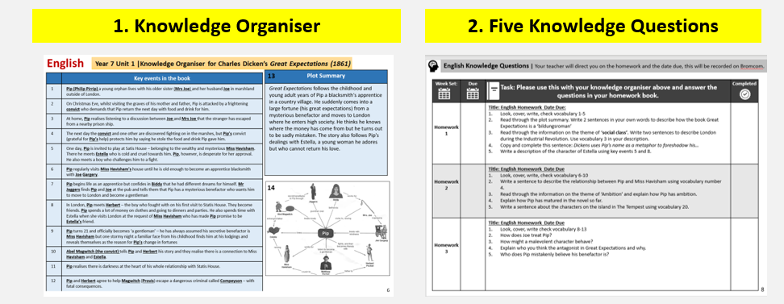
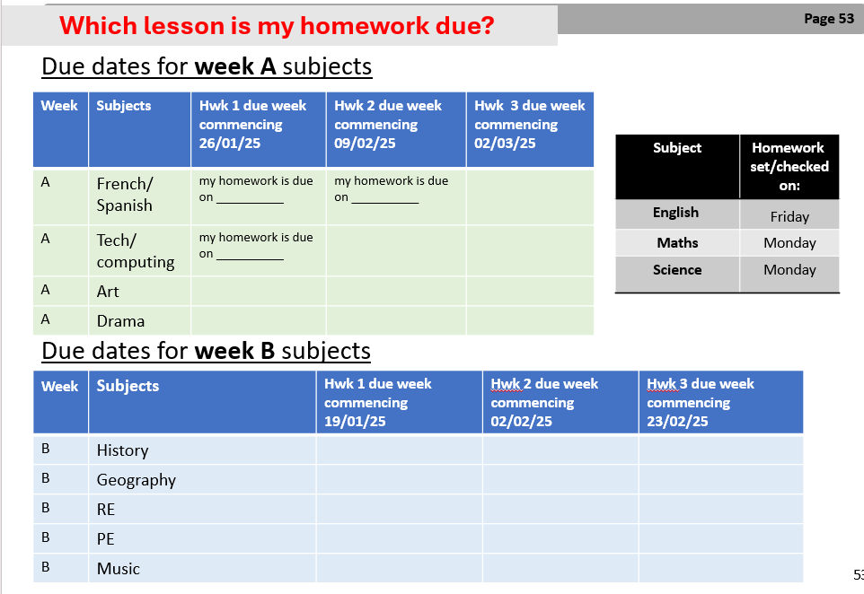
Handout: Year 7, 8 and 9 homework system at BBA
What the homework is:
Knowledge organiser homework for core subjects every week and noncore every other week (week A/B system)
Students write answers in their red homework book
Mathswatch for maths homework, music homework also online.
Timetable Rock Star
20 minutes reading everyday
How you can support:
Praise or reward completion
Check list of what to remind your child:
Check the due dates for the different subjects on the back page of the knowledge organiser
Do core subject homework every week (including mathswatch)
To do Timetable Rock Star
Read everyday for 20 minutes
Ask for support if unsure (tutor, subject teacher, homework club)
Deadlines assigned by teachers at the back of the knowledge organiser
Where?
Paper copies of knowledge organisers are given to students at the start of every term
Digital copy on the student portal
Digital copies on the Bristol Brunel academy website.
Bristol Brunel Academy website> Curriculum> Knowledge Organisers
What do we do at BBA to support your child?
Tutor time support
Monday and Thursdays after school homework club, in Library. With at least 2 LSAs on both days.
Non- core subject due dates reminder on the last page of the knowledge organiser
Knowledge organisers in Learning Support

Slide 3
Year 7,8 and 9 Knowledge Organiser homework: What is it?
Knowledge Organiser Homework with 5 x Knowledge Questions
20 minutes of reading per day
Between 5 – 15 minutes of Timetable (TT) Rock Stars a day
Maths homework on Mathswatch
Rewards and sanctions:
1 house point per completion
Stamps and stickers per completion
Non-completion -1 point

Slide 4
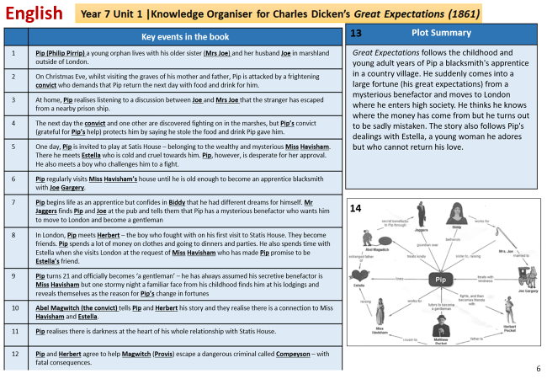
Knowledge Based Learning
'Evidence supporting a knowledge-based curriculum in the UK includes research showing that a strong focus on subject-specific knowledge leads to improved academic attainment for students' www.gov.co.uk
Evidence supporting a knowledge based curriculum

Slide 5
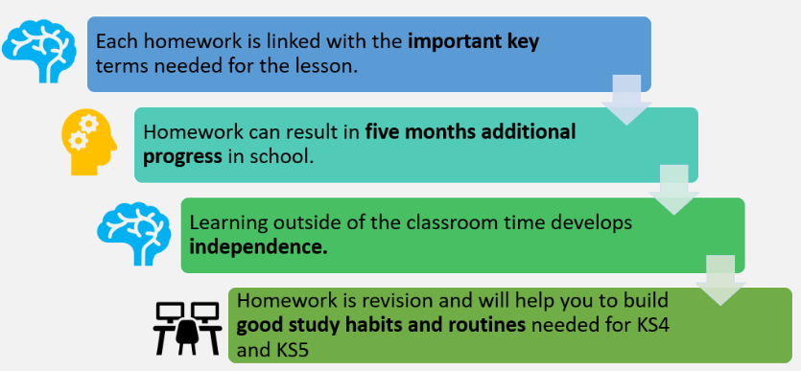
Why is homework important at BBA?
Survey: what our students think
37% - to help me build subject knowledge
25% - to make lessons easier
28% - to help me revise for assessments

Slide 6
Knowledge Organiser homework: why is it important?
Pre-learning of knowledge prior to the lesson
Develop good study habits and routines earlier
Develop independence
Notes:
Farva

Slide 7
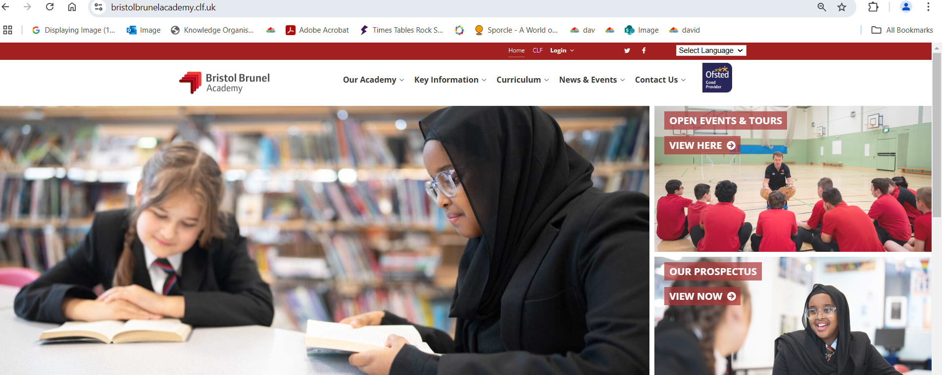
Where to find the Knowledge Organisers
Hard copy given to students at the start of each term
Digital copy on the student portal
Digital copy on the Bristol Brunel Academy Website (https://bristolbrunelacademy.clf.uk) Curriculum> Knowledge Organisers

Slide 8
What do we do at BBA to support your child?
Feedback on homework quality to match classwork
Tutor time support
Monday and Thursdays after school homework club, in Library with at least 2 LSAs on both days.
Digital and hard copies of Knowledge Organisers
End page of the Knowledge Organiser for due dates
Knowledge Organisers in Learning Support
From the survey:
Most students (63%) look to their families and friends for support
84% of parents think their child knows what to do and that they work without support.

Slide 9
What can you do to support your child?
Encourage them! Remind them about the benefits of homework
Quality assure homework: have they spent 20 minutes on the subject? Is this the standard they can work at?
Encourage them to ask their tutor or teacher for support in case unsure
Ask to see their red homework book, to see they are completing homework.​
Praise them on completion
How can this be achieved when you are battling with screen time?
How can you support?
Praise or reward completion
Check list of what to remind your child:
Check the due dates for the different subjects on the end page of the Knowledge Organiser
Do core subject homework every week (including Mathswatch)
To do Timetable Rock Star
Read every day for 20 minutes
Ask for support if unsure (tutor, subject teacher, homework club)

Slide 10
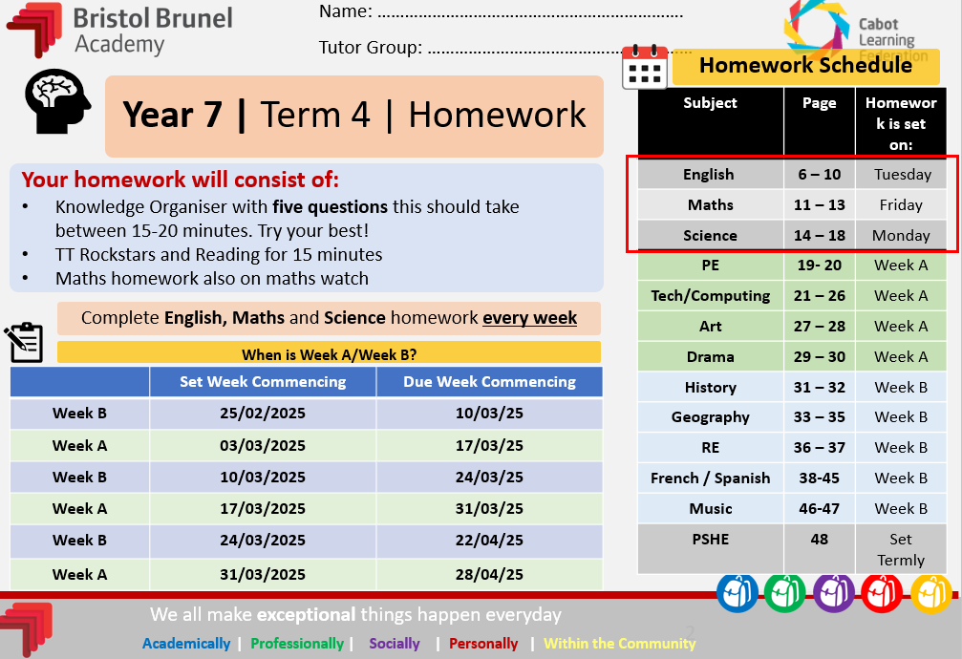
Knowledge Organisers - how to use:

Slide 11
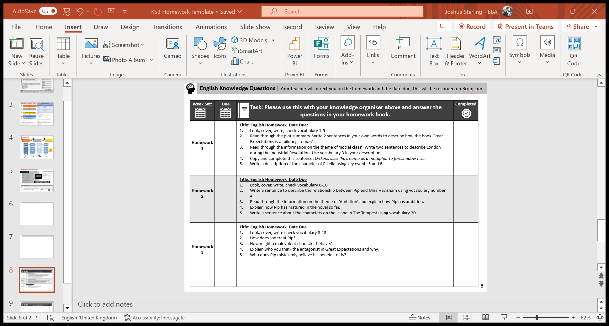
Knowledge Organisers - how to use:
Homework
1. Knowledge Organiser
2. Five Knowledge Questions
Using homework as a guide to revision

Slide 12
1. Subject
2. Key terms are numbered:
Your teacher will direct you on the key terms to focus on.

Slide 13
Your homework explained – Knowledge Questions
Must be completed in the Red Homework book.
Due date
The due date is the student portal

Slide 14
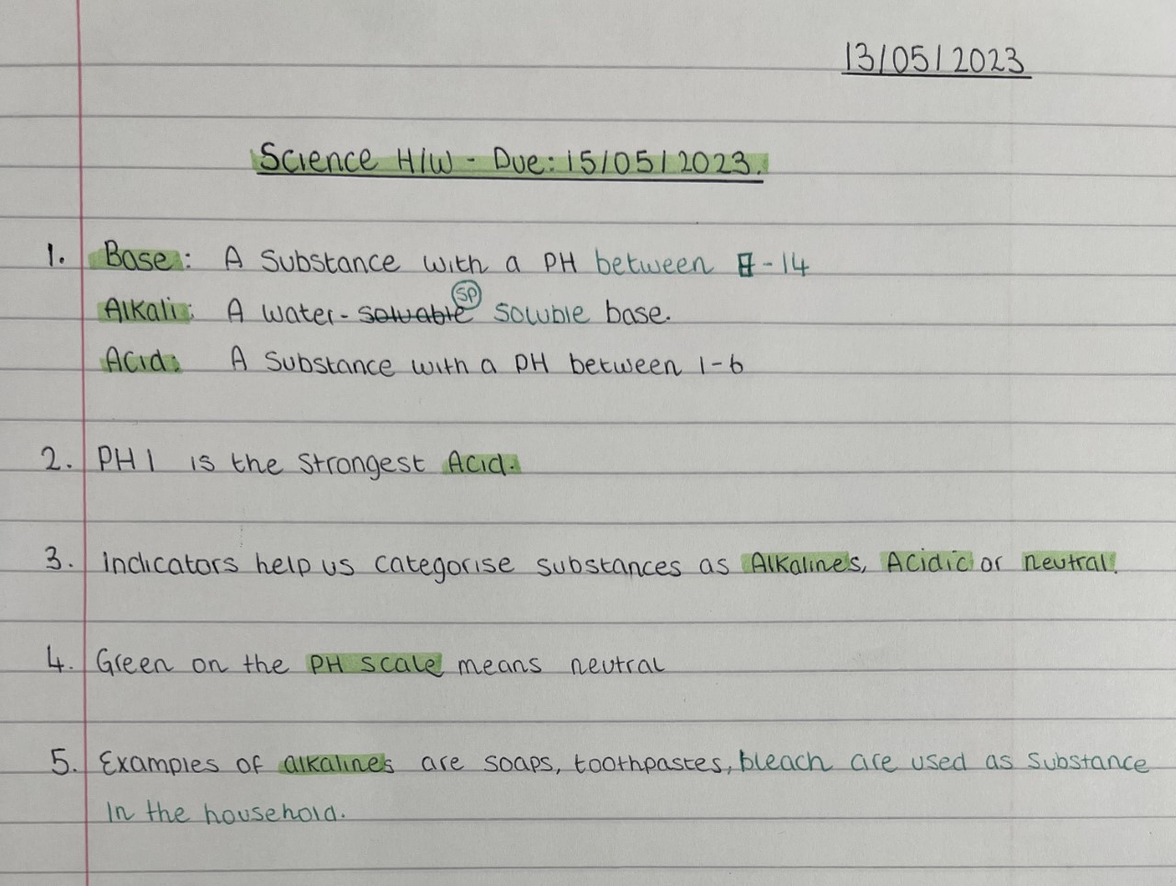

Title with the subject name and due date
Step 1: Class Teacher
In the first instance, you need to speak with your class teacher
Step 2: Tutor
If you are still unsure, then speak with your tutor.
Monday and Thursday homework club after school
2. Look, cover, write & check the key terms identified by your teacher.
3. Answer the questions, using full sentences. Self-correcting using a different colour, normally a green

Slide 15
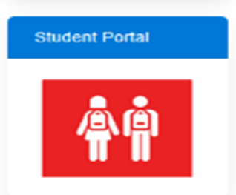
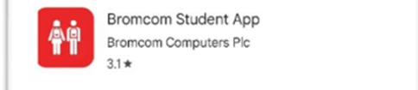
Homework has moved to the Student Portal
Students can access homework on:
The Student Portal tile on the browser
Or
Download and use the Bromcom Student App on their phone, iPad or tablet
Students can now access homework resources, due dates for knowledge organiser homework, timetable, behavior points and attendance, all in one app.

Slide 16
Knowledge Organisers - how to use:
Core subjects
Timetable week A/B
Student portal
5 question answers on the red homework book
20 minutes homework

