Slide 1





Name: ………………………………………………………….
Tutor Group: ………………………………….………………
Year 9 | Term 5| Homework
Homework Schedule
Subject | Page | Homework is set on:
English | 6-10 | Thursday
Maths | 11- 13 | Friday
Science | 14 – 17 | Friday
PE | 18 - 19 | Week A
Tech/Computing | 20 – 28 | Week A
Art | 29 – 30 | Week A
Drama | 31 – 32 | Week A
History | 33 – 34 | Week B
Geography | 35 - 37 | Week B
RE | 38 – 40 | Week B
French / Spanish | 41- 52 | Week B
Music | 53 – 54 | Week B
PSHE | 54 | Set Termly
Your homework will consist of:
Knowledge Organiser with five questions this should take between 15-20 minutes. Try your best!
TT Rockstars and Reading for 15 minutes
When is Week A/Week B?
 | Set Week Commencing | Due Week Commencing
Week B | 22/04/25 | 05/05/25
Week A | 28/04/25 | 12/05/25
Week B | 05/05/25 | 19/05/25
Week A | 12/05/25 | 02/06/25
Week B | 19/05/25 | 09/06/25

Slide 2


How to present my homework book
Need help with Homework?
1) Class Teacher: Speak to your class teacher, they will be able to help you if you are unsure. Try your best and don’t worry if you do not complete everything.
2) Tutor: If you are still unsure, speak with your tutor. Especially, If you have lost equipment, this booklet or having issues with SMHW.
3) Year Team: Once you have contacted your teacher and tutor and still need help, then contact your Year team.
Struggling with the task: You can email the Curriculum Leaders below:
 | Email |  | Email
English | hannah.powell-bond@clf.uk | History | Jenny.Chapman@clf.uk
Maths | David.Busby@clf.uk | Geography | emilia.fuorvito@clf.uk
Science | timothy.sperring@clf.uk | RE | emilia.fuorvito@clf.uk
PE | Victoria.Payton@clf.uk | French / Spanish | Laura.miles@clf.uk
Tech/Computing | Naomi.Soper@clf.uk Martin.Wignall@clf.uk | Music | drew.salida@clf.uk
Art | kealy.darby@clf.uk | PSHE | amelia.perry1@clf.uk
Drama | Joanne.Ayre@clf.uk | Year Team | BBAyear9team@clf.uk

Slide 3





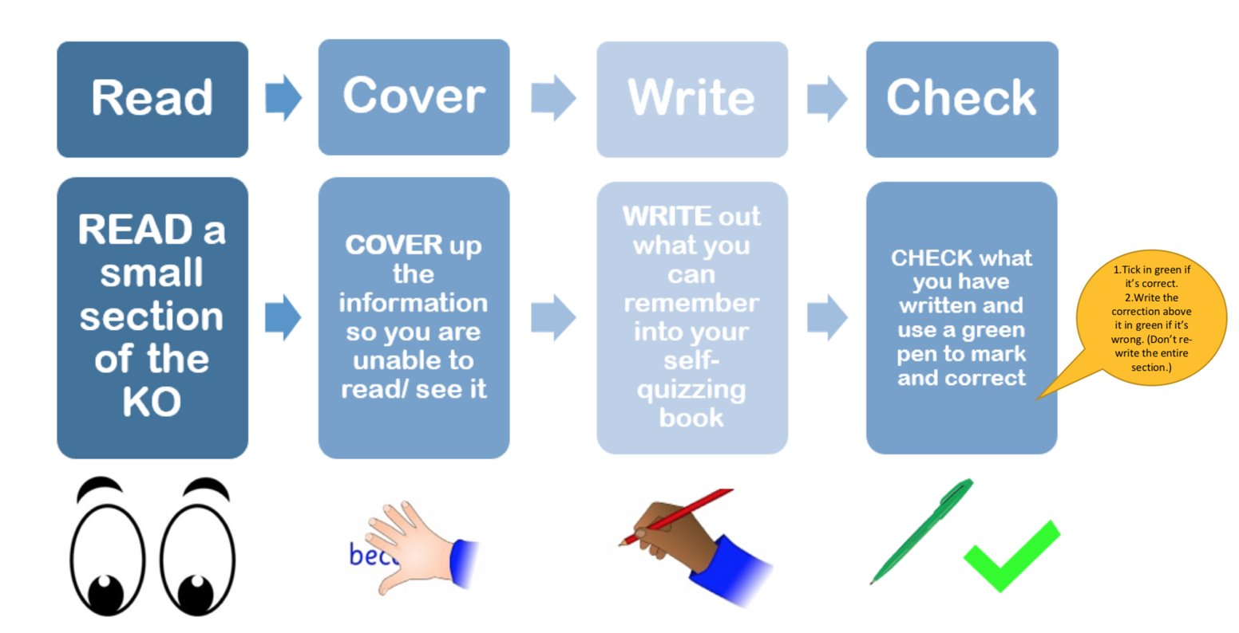
How to complete my homework
You will need
This page will explain how you should complete your homework.
You can go on our website to help you too.
Homework book
Green and Red Pen
Optional: Timer: Set for 20 minutes
1) Class Teacher: Speak to your class teacher, they will be able to help you if you are unsure. Try your best and don’t worry if you do not complete everything.
2) Tutor: If you are still unsure, speak with your tutor. Especially, If you have lost equipment, this booklet or having issues with SMHW.
3) Year Team: Once you have contacted your teacher and tutor and still need help, then contact your Year team.
Instructions: How to complete my homework
I need help with my homework
For each homework you will be asked to look at a particular section of your Knowledge Organiser. Set a timer for 20 minutes.
2. Read a small section of the Knowledge Organsier, your teacher will tell you the key term numbers to learn for your homework.
3.Cover up the information so you are unable to read/see it.
4. Write: In your red homework book, Write what you can remember. This should include both the Key term and definition.
5. Check: Check the Knowledge Organiser to see if you got the key term and defintions correct. Correct any mistakes using a green pen
6. Complete the other knowledge questions. Please stop if you run out of time.
Notes:
Your Knowledge Organiser contains the essential knowledge that every student must know.
Regular use of the Knowledge Organiser helps you to recap, revise and revisit what you have learnt in lessons.
The aim is to help remember this knowledge in the long term.
You will use the Knowledge Organiser to help learn during homework.

Slide 4


How to present my homework book
Title with the Subject name and due date
13/09/2023
Science H/W – Due 15/09/2023
1.
Base: A substance with a PH between 8-14
2. Look, cover, write & check the key terms and definitions identified by your teacher. Try your best.
Alkali: A water soluable soluble base.
2.
PH1 is the strongest acid
3.
Indicators help us categorise substances such as alkaline, acids or neutral.
3. Answer the questions, using full sentences. Self-correcting using a green pen.
Subject | Additional Tasks
English | You should read for 15 minutes a day and record this in your reading log provided by your English teacher.
Maths | TT Rockstars: Times Tables Rock Stars is a fun and challenging programme designed to help you master the times tables. 5 to 15 minutes practice a day, Ask your Maths teacher or tutor if you require a new log in. | To help you remember write down your: Username: Password:

Slide 5

English
The Merchant of Venice
First published in 1600
Set in Venice, Italy
Originally classed as a comedy, but has become to be seen as more tragic over time.
CHARACTERS:
Antonio - A wealthy Venetian merchant who occasionally lends money, but never charges interest. He is the "merchant" of the play's title.
Bassanio - He is a typical Elizabethan lover and nobleman who is careless with his money; hence, he has to borrow from Antonio so that he can woo Portia in style.
Portia - She is famous for her beauty and for her wealth, and she is deeply anguished that she must marry the man who chooses the single casket of three which contains her portrait.
Shylock - An intelligent businessman who believes that, since he is a moneylender, charging interest is his right; to him, it makes good business sense.
CONTEXT
Shakespeare – first performed in 1600s
Italy (Venice) as a global trading center
Prejudice, particularly anti-Semitism:
Jews were banished from England, and in Venice they lived in segregated areas and had to wear an identifying badge.
Revenge tragedy – has two tragic heroes (Antonio and Shylock) and their hamartia is based on a need for revenge against the other.
Comedy – two groups pitted against each other / disguise / men dressed as women, and vice versa / innuendo / marriage.
The role of women – women could not act on stage in Shakespeare’s time, so the trial scene would have been very funny, with male actors dressed as women pretending to be men.
Women had a lesser status when the play was set – this is shown through Portia being unable to choose whom she marries.
THEMES:
Tragedy
Comedy
Tension
Revenge
Money
Female characters
Hope
Religion
Love
Romantic relationships
Platonic (non-romantic) relatonships
Families (particularly fathers & daughters)
Trust

Slide 6
English
THEMES AND SYMBOLS:
The pound of flesh – this represents Shylock’s hatred for Antonio, and links to Shakespearean tragicomedy ideals of revenge and justice.
The rings – Portia and Nerissa give Bassanio and Gratiano a ring each and make the men promise not to remove them. The rings link to Shakespearean comedy (marriage and disguise). Jessica also steals a ring given to Shylock by his deceased wife, Leah.
Justice – Anti-Semitic attitudes would suggest that justice is served when Shylock is forced to convert to Christianity. Modern audiences would not consider this to be the case.
Money - Venice was an important trading port. Venice is characterised by money and Belmont by love. Money acts as a catalyst for revenge.
Revenge Tragedy / Tragicomedy – As a problem play, MoV has characteristics of both Shakespearean tragedy and comedy.
QUOTATIONS:
"I will not eat with yolu, drink with you, nor pray with you.’ (Shylock)
‘My purse, my person, my extremist means, lie all unlocked to your occasions’ (Antonio to Bassanio)
‘I cannot choose one nor refuse none’ (Portia about suitors)
‘I hate him for he is a Christian’ (Shylock about Antonio)
‘The devil can cite scripture for his purpose’ (Antonio about S)
‘The portrait of a blinking idiot’ (Aragon)
‘I am never merry when I hear sweet music’ (Jessica)
‘The quality of mercy is not strained’ (Portia)
‘Though I am a daughter to his blood, I am not to his manners’ (Jessica about Shylock)
‘if you wrong us, shall we not revenge?’ (Shylock)
‘an inhuman wretch uncapable of pity’ (Duke about Shylock
KEY WORDS:
Platonic – non-sexual, non-romantic affection for someone (e.g. friendship)
Anti-Semitism – prejudice against Jewish people
Usury – lending money with an unreasonably high interest rate
Stereotype – an oversimplified belief of a particular group or thing
Motif
Conform – to comply with rules, laws or standards
Vengeful – to seek to hurt someone in return for a perceived injury

Slide 7
English
Year 9 – The Merchant of Venice – Knowledge Organiser
 | Vocabulary | Definition |  | Vocabulary | Definition
1 | Credit | the ability of a customer to obtain goods or services before payment, based on the trust that payment will be made in the future. | 8 | Discrimination | the unjust or prejudicial treatment of different categories of people, especially on the grounds of ethnicity, age, sex, or disability.
2 | Usury | the action or practice of lending money at unreasonably high rates of interest. | 9 | Vengeful | seeking to harm someone in return for a perceived injury; getting revenge
3 | Stereotype | a widely held but fixed and oversimplified image or idea of a particular type of person or thing. | 10 | Soliloquy | an act of speaking one's thoughts aloud when alone, especially by a character in a play.
4 | Unconditional | not subject to any conditions; absolute. | 11 | Avarice | extreme greed for wealth or material gain
5 | Platonic | (of love or friendship) intimate and affectionate but not sexual. | 12 | Materialistic | excessively concerned with material possessions; money-oriented.
6 | Patriarchy | a system of society or government in which men hold the power and women are largely excluded from it. | 13 | Motif | a dominant or recurring idea in an artistic work
7 | Prejudice | A preconceived opinion that is not based on reason or actual experience. | 14 | Dramatic Irony | a literary technique, originally used in Greek tragedy, by which the full significance of a character's words or actions is clear to the audience or reader although unknown to the character.

Slide 8


English
Instruction: for each homework, you will be asked to look at a particular section of your Knowledge Organiser to help you answer the questions using full sentences. Each task should take 20 minutes, Set a timer and stop when the time runs out.
Homework | Due | Task:
Homework 1 ​ |  | Look, cover, write, check vocabulary 1-5. What is usury? Write one sentence using this word in relation to The Merchant of Venice. Why was Venice important in Elizabethan times? Write a sentence summarising this. List three expectations of women in the Elizabethan era. What is the meaning of credit? How might credit turn into something negative?
Homework 2 ​ ​ |  | Look, cover, write, check vocabulary 6-10. Write one sentence outlining how platonic relationships are shown so far in The Merchant of Venice. What is the meaning of usury? How is this represented in The Merchant of Venice? List a reason why Venice would be a multicultural city in Elizabethan times. Why might unconditional love be dangerous? Summarise in a sentence.
Homework 3 ​ |  | Look, cover, write check vocabulary 8-12. Define anti-Semitism in a sentence using the word prejudice. How is Shylock a victim of prejudice? Write a sentence summarising this. List one way that Portia conforms to gender expections of Elizabethan women. List one way that Portia subverts gender expectations of Elizabethan women.
Completed?
Completed?
Completed?
Notes:
For each homework you will be asked to look at a particular section of your Knowledge Organiser. Set a timer for 20 minutes.
1. Look cover write check 1-5 2. Who is the protagonist in Great Expectations? 3. Explain how Great Expectations is a bildungsroman. 4. Who was the most malevolent character in Trash in your opinion? 5. Which words in the Estella key character quotation suggest she believes she is superior to Pip?

Slide 9

English
Instruction: for each homework, you will be asked to look at a particular section of your Knowledge Organiser to help you answer the questions using full sentences. Each task should take 20 minutes, Set a timer and stop when the time runs out.
Homework | Due | Task:
Homework 4 ​ |  | Look, cover, write check vocabulary 1,3,5,7,9. How would Shylock feel about lending money towards Bassanio, for Antonio? Summarise in a sentence. What evidence is there of prejudice in Shakespeare's description of Shylock? What is the message behind Maya Angelou's poem "Still I Rise"? What do you predict will happen between Antonion and Shylock?
Homework 5 ​ ​ |  | Look, cover, write check vocabulary 2,4,6,8,10. Summarise the casket game in a sentence, using the word patriarchy. Who is coming to visit Portia in the evening? How does Portia feel about the casket game? Summarise in a sentence. Which casket is likely to be correct? Why?
Completed?
Completed?
Notes:
For each homework you will be asked to look at a particular section of your Knowledge Organiser. Set a timer for 20 minutes.

Slide 10
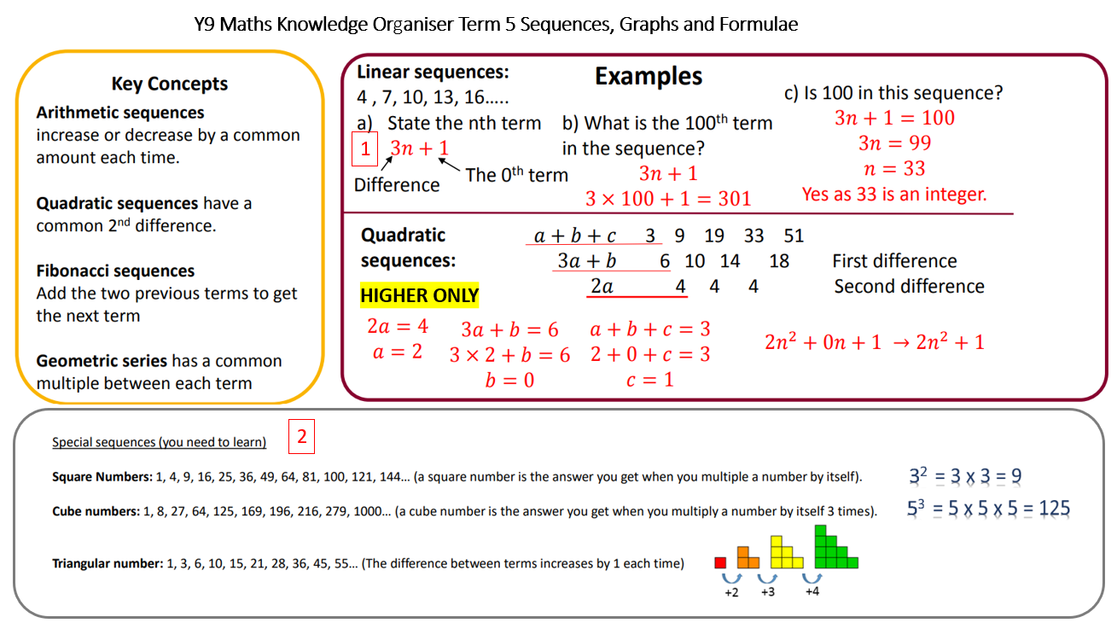
Maths

Slide 11
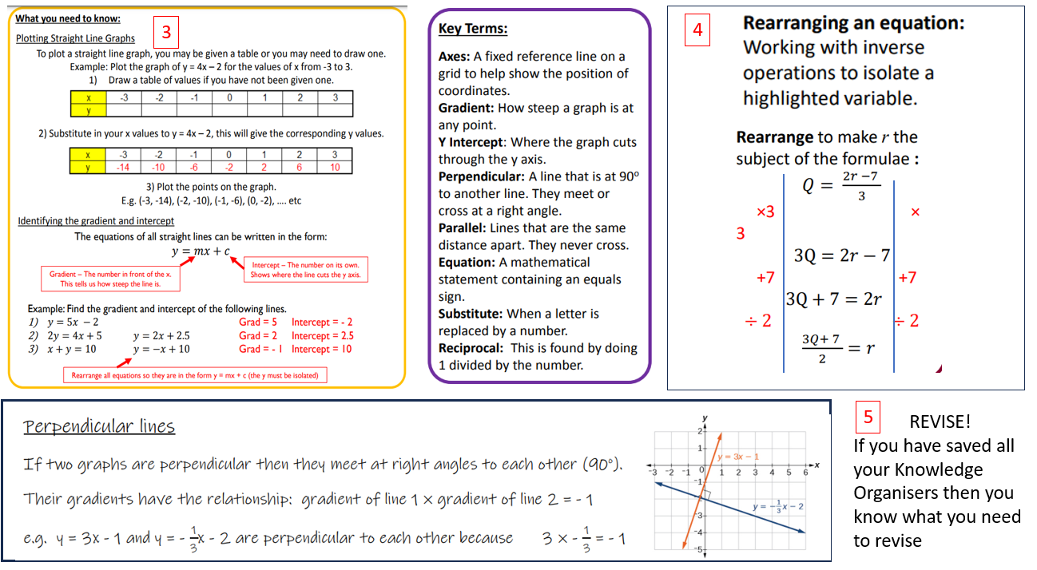
Maths

Slide 12
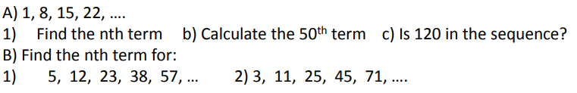



Maths
Instructions:
In addition, students will receive online homework via the Mathswatch website every Friday. This needs to be completed alongside the knowledge questions and times tables practice"
"The website is https://vle.mathswatch.co.uk/vle/, student usernames are their school email address and the password is always bristol"
Homework | Due | Task:
Homework 1 ​
Homework 2 ​ |  | Create a poster / Flashcard to help you to remember how to recognise a Fibonacci sequence and the square, cube and triangle numbers
Homework 3 |  | a) Can you sketch the graph created from the table … what is the gradient?, what is the y intercept? B) Name two lines that are parallel to the line given. EXT: Make sure you are clear on identifying the equation of perpendicular lines .
Homework 4 |  | rearrange the following formulae to make x the subject:
​Homework 5 |  | Use your knowledge organisers and the revision list to prepare for the assessment in Term 6.
Complete?
Complete?
Complete?
Complete?
5
Completed?

Slide 13


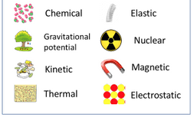
Science //Energy
 | Key Term | Definition
1 | Kinetic energy store (K.E.) | Energy stored in moving objects
2 | Gravitational energy store (G.P.E) | Energy stored in objects held at a height above the ground
3 | Joules (J) | The units of energy
4 | Efficiency | A measure of how much energy transferred to a device is useful, compared to the amount which is wasted
5 | Dissipated | A term used to describe energy that is being wasted – often to the thermal store of the surroundings.
The Law of the Conservation of Energy: Energy cannot be created or destroyed. It can be stored, transferred between stores and dissipated.
A moving object has energy in its kinetic energy store.
The amount of energy in its kinetic store depends on its mass and its velocity
We can use the equation below to work out the amount of energy in a kinetic store:
Kinetic energy = ½ x mass x velocity²
E.g. a car with a mass of 1450kg is travelling at 28 m/s. We can work out its kinetic energy stored using the equation:
Kinetic energy = ½ x 1450 x (28)²
Kinetic energy = 568 400 J
An object held at a height has energy in its gravitational potential energy store:
The amount of energy in its gravitational store depends on its mass and its height, as well as the gravitational field strength on the Earth’s surface (10 N/kg)
We can use the equation below to work out the amount of energy in a gravitational store:
Change in gravitational potential energy = mass x gravity x change in height
E.g. A cat of 7kg is lifted 5m into the air. How much GPE does it gain?
GPE = mass x gravity x change in height
= 7 x 10 x 5 = 350J
There are 8 different energy stores that you need to know:
Energy is transferred by one of the following four types of energy transfer:
Mechanical work - a force moving an object through a distance
Electrical work - charges moving due to a
Heating - due to temperature difference caused electrically or by chemical reaction
Radiation - energy transferred as a wave, eg light and infrared - light radiation and infrared radiation are from the sun
Doing 'work' is the scientific way of saying that energy has been transferred.

Slide 14

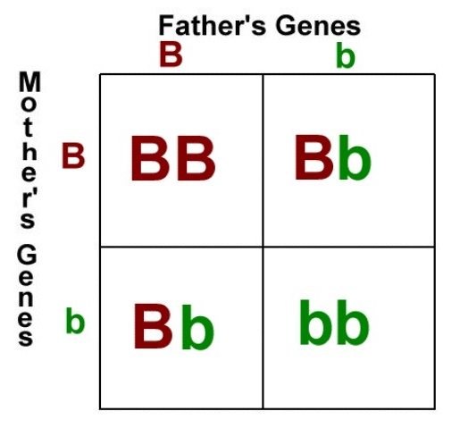
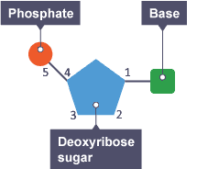
Science // Genetics
 | Key Term | Definition
1 | Meiosis | Cell division which produces gametes (reproductive cells).
2 | Chromosomes | Long coils of DNA molecules found in the nucleus of eukaryotic cells
3 | Gene | Short section of DNA which codes for a protein
4 | Genotype | Combination of alleles for a certain characteristic
5 | Phenotype | Expressed characteristics e.g. hair colour, eye colour, ability to tongue roll etc.
Sexual reproduction and Meiosis
Gametes (sex cells) are produced by a cell division process called meiosis
This process is similar to mitosis, but instead of one round of cell division, there are two rounds. The table below compares mitosis and meiosis:
 | Mitosis | Meiosis
DNA replication? | Yes | Yes
Number of round of cell division | 1 | 2
Number of daughter cells produced | 2 | 4
Daughter cells genetically identical? | Yes | No
Purpose | Growth and repair | Producing gametes
DNA Structure
DNA strands are polymers, meaning they are made up of lots of repeating units joined together
DNA is the molecule which carries all the instructions for your characteristics
It has a double helix structure meaning it is two coils of DNA wrapped around each other
Genetic diagrams: Punnett Squares
A dominant allele is always expressed with just one copy and is represented by a capital letter, such as B for brown eyes.
A recessive allele is only expressed when two copies are present and is denoted by a lowercase letter, like b for blue eyes.
A Punnett square diagram can be used to show the inheritance of a single characteristic (monohybrid inheritance)
This Punnett square diagram shows the probable outcomes for offsprings’ eye colour from a mother and father who are both heterozygous
If the two alleles for a particular gene that are the same (e.g. BB or bb), it is homozygous for that trait. If the two alleles for a particular gene are different (Bb), it is heterozygous for that trait
The basic units of DNA are nucleotides – each nucleotide contains a deoxyribose sugar, phosphate and a base.
The base could either be adenine, (A), thymine (T), cytosine (C), or guanine (G)
Adenine always pairs with thymine (A and T)
Cytosine always pairs with guanine (G and C)
The complimentary base pairs are held together by hydrogen bonds

Slide 15
Science
Instruction: for each homework, you will be asked to look at a particular section of your Knowledge Organiser to help you answer the questions using full sentences. Each task should take 20 minutes, Set a timer and stop when the time runs out.
Homework | Due | Task:
Homework 1​​ 1​ ​Energy​ |  | Read, cover, check terms 1-5​ Name the eight different ways in which energy can be stored ​ What is the Law of the Conservation of energy?​ State the equation used to calculate kinetic energy ​ Calculate the kinetic energy of a 1200kg moving vehicle which is travelling at 27 m/s​
Homework​ 2​ Energy​ ​​ |  | Read, cover, check terms 1-5​ Name the eight different ways in which energy can be transferred​ State the equation used to calculate gravitational potential energy ​ Calculate the change in gravitational energy stored when a 70kg man climbs stairs which have a vertical height of 3m on Earth (gravitational field strength is 10 N/kg)​ Calculate the change in gravitational energy stored if the same man climbed a height of 3m on the moon (gravitational field strength 1.7 N/kg)
Homework​ 3​ Genetics ​ ​​ |  | Read, cover, check terms 1-5​ Name the type of structure that a DNA molecule has ​ Which base pairs with guanine? ​ What is the purpose of meiosis​ Describe two differences between the outcomes of mitosis and meiosis​
Completed?
Completed?
Completed?
Notes:
For each homework you will be asked to look at a particular section of your Knowledge Organiser. Set a timer for 20 minutes.

Slide 16
Science
Instruction: for each homework, you will be asked to look at a particular section of your Knowledge Organiser to help you answer the questions using full sentences. Each task should take 20 minutes, Set a timer and stop when the time runs out.
Homework | Due | Task:
Homework​ 4​ Genetics​ ​ | ​ | Read, cover, check terms 1-5​ What type of allele is represented by a capital letter?​ What does it mean if you are homozygous for a gene?​ What type of diagram is used to show the inheritance of a single characteristic?​ Use the Punnett square on p.28. What is the percentage chance an offspring will be heterozygous for eye colour? ​
Completed?
Notes:
For each homework you will be asked to look at a particular section of your Knowledge Organiser. Set a timer for 20 minutes.

Slide 17
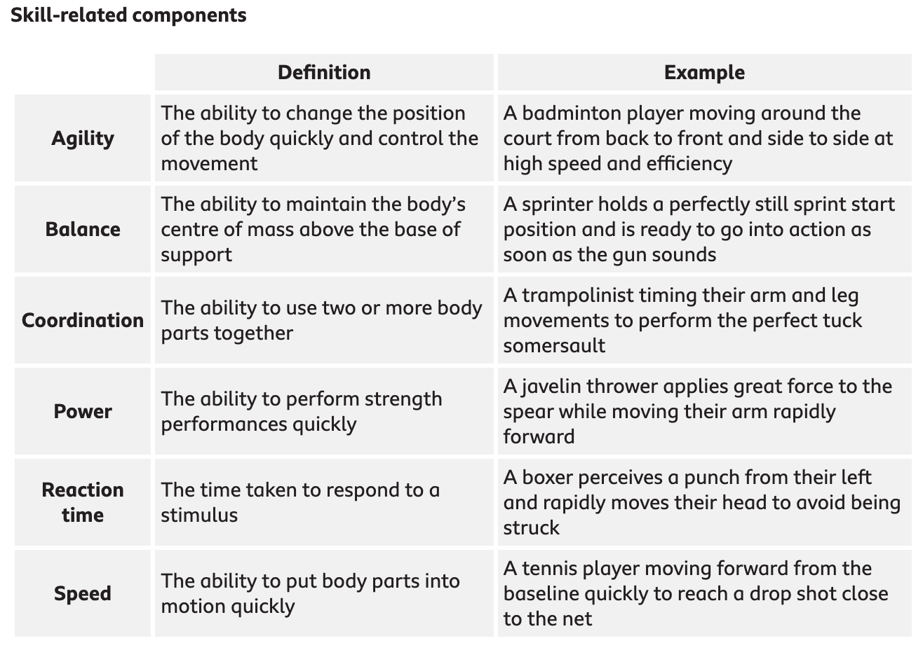
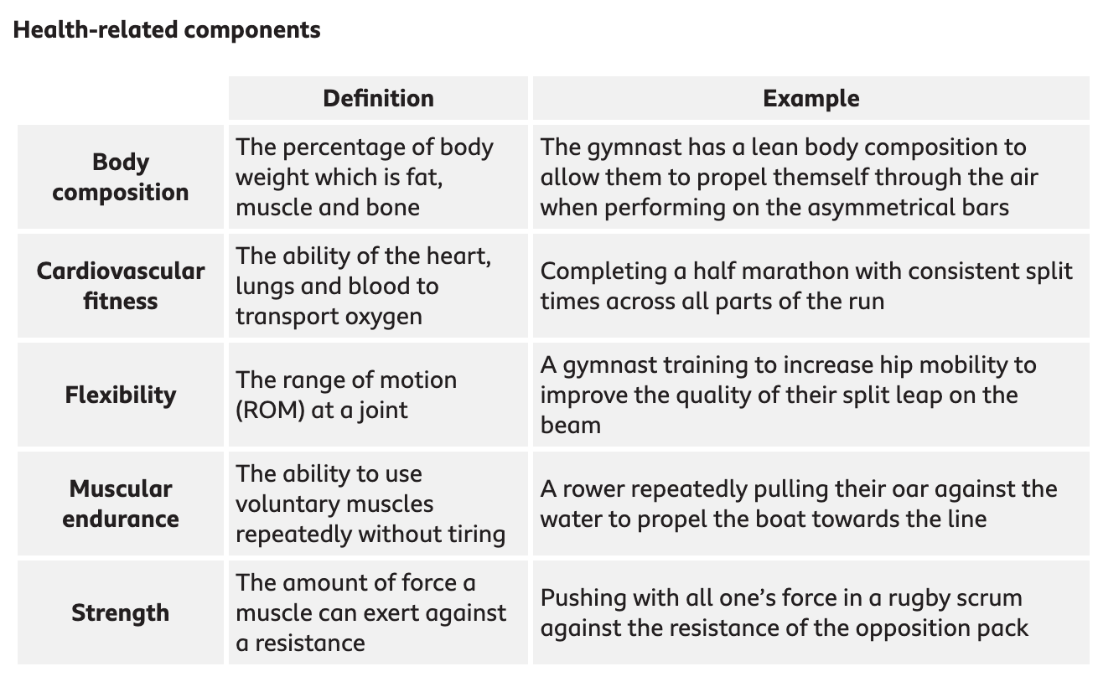
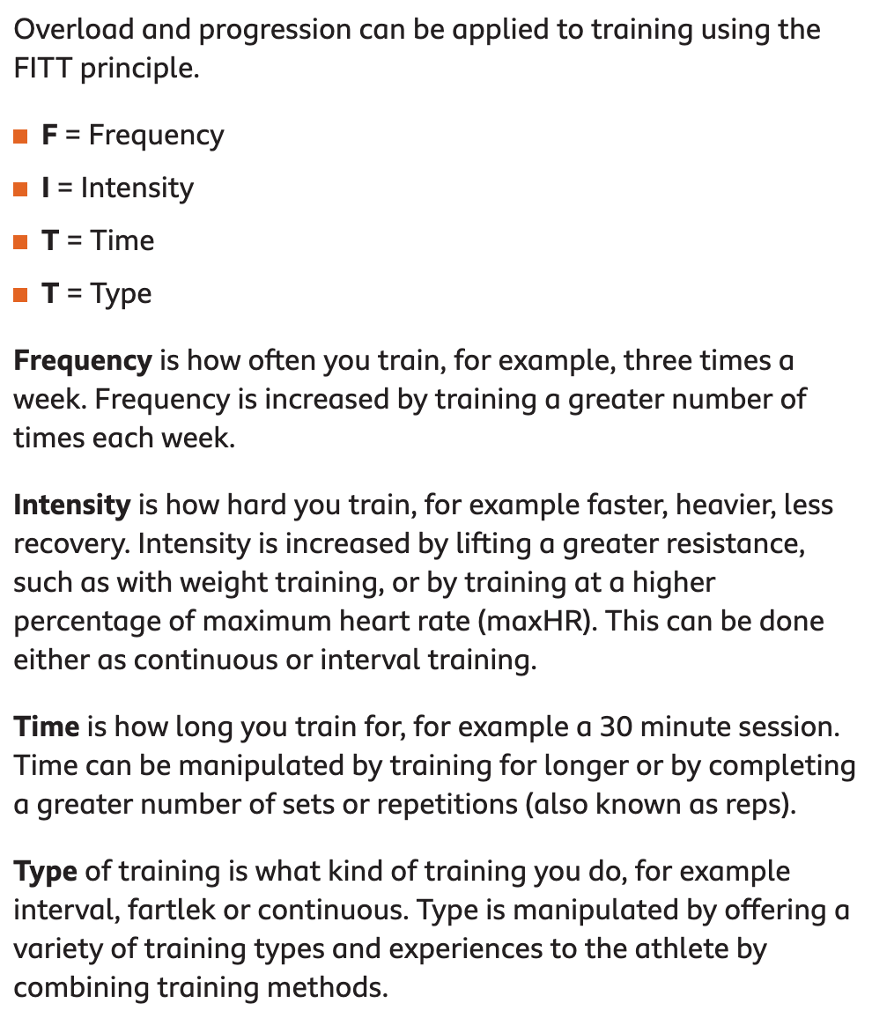
PE

Slide 18
PE
Instruction: for each homework, you will be asked to look at a particular section of your Knowledge Organiser to help you answer the questions using full sentences. Each task should take 20 minutes, Set a timer and stop when the time runs out.
Homework | Due | Task:
Homework 1 |  | Look, cover, write, check Key Words and definitions 1-4. In what sport is Cardiovascular Endurance important? Can you give a different sporting example of coordination? Give an example of how you can use frequency to improve your fitness? Can you give a different sporting example of balance?
Homework 2 ​ |  | Look, cover, write, check Key Words and definitions 1-4. In what sport is Flexibity important? Can you give a different sporting example of Power? Give an example of how you can use Intensity to improve your fitness? Can you give a different sporting example of reaction time?
Homework 3 ​ |  | Look, cover, write, check Key Words and definitions 1-4. In what sport is Strength important? Can you give a different sporting example of Agility? Give an example of how you can use time to improve your fitness? Can you give a different sporting example of Speed?
Completed?
Completed?
Completed?
Notes:
For each homework you will be asked to look at a particular section of your Knowledge Organiser. Set a timer for 20 minutes.

Slide 19
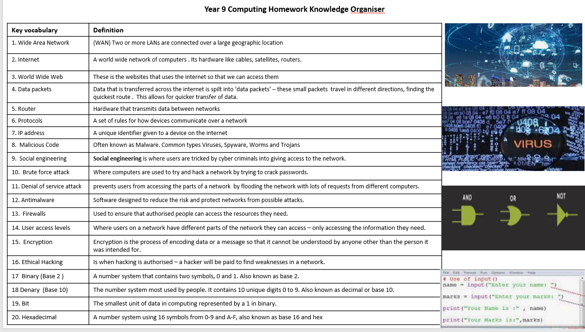
Computing

Slide 20
Computing
Key vocabulary | Definition
21. Sample rate | How many times a second sound is recorded. The more times it is sampled per second the better the quality of recorded sound.
22. Sampling | The measuring of sound . Sampling is measured in cycles per second called the sample rate.
23. Bit depth | The number of bits (0’s and 1’s) available for each sample of music. The greater the bit depth the closer to the original sound.
24.Bit rate | The number of bits per second used to record audio. The higher the bit rate the better quality the sound will be.
25. Boolean Logic | There are two states in Boolean logic - True and False.
25. Logic gate | A logic gate is made up of a number of transistor switches arranged in a certain way – it is how computers make decisions
27. AND gate | And gates rely on both inputs being true for the output to be true e.g. money inserted and vending machine button pressed for the drink to be dispensed.
28. OR Gate | Or gate needs at least of the inputs to be true for the output to be true e.g pin or fingerprint will open your phone.
29. NOT gate | The output is opposite of the input e.g. if the fridge door is not closed then light is on.
30 Sequence | The specific order in which instructions are performed in an algorithm.
31. Selection | Allows for more than one path through an algorithm (IF and ELSE).
32. Iteration | The process of repeating steps (WHILE and FOR).
33. Syntax error | An error in the rules for writing in the programming language e.g. no closing bracket which will stop the program from running.
34. Logic error | An error in which the program will still run but will produce an unexpected output.
35. String | A data type used for a combination of any characters that appear on a keyboard, such as letters, numbers and symbols.
36. Integer | A data type used for whole numbers.
37. Float | Used for numbers that contain decimal points, or for fractions.

Slide 21
Computing
Instructions: You are on a rotation with Technology. If you are unsure, please speak to your teacher.
For each homework, you will be asked to look at a particular section of your Knowledge Organiser, to help you answer the questions using full sentences.
Each task should take 20 minutes, Set a timer and stop when the time runs out.
Homework | Due | Task:
Homework 1 |  | Look, write, cover, check vocabulary 17-24 Explain why programmers use hexadecimal? Explain the term ‘sampling’ with regards sound files. How does the sample rate effect the quality of sound? Explain the term bit rate and how this affects the quality of the sound and the file size of the sound file?
Homework 2 ​ |  | Look, write, cover, check vocabulary 25-29 Draw an AND gate. What’s the rule for an AND gate? Draw an OR gate. What’s the rule for an OR gate? Draw a NOT gate. What’s the rule for a NOT gate?
Homework 3 ​ |  | Look, write, cover, check vocabulary 30-34. What is ‘sequence’ in programming What is ‘selection ’ in programming What is ‘iteration ’ in programming What is a ‘string’ in python What is an ‘integer’ in python
Completed?
Completed?
Completed?

Slide 22
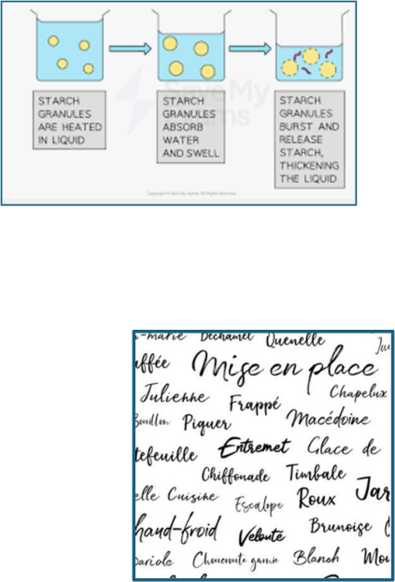
Technology | Food
Important vocabulary
Key word | Meaning
1. Staphylococcus | Bacteria found on STAFF which causes food poisoning due to poor personal hygiene.
2. E Coli 0157 | Bacteria often found on red meat from animal's insides which causes food poisoning.
3. Bacillus cereus | Bacteria often found on rice which causes food poisoning.
4. Gelatinisation | When a starchy food swells when heated and then absorbs/ thickens e.g. flour thickens a white sauce. Potatoes, pasta and rice swell and soften when cooked.
5. Justification | Making a statement and supporting it with a reason or example.
6. Mise-en-place | French for 'Put in place' = preparation before cooking.

Slide 23
Food
Instruction: for each homework, you will be asked to look at a particular section of your Knowledge Organiser to help you answer the questions using full sentences. Each task should take 20 minutes, Set a timer and stop when the time runs out.
Homework 4 |  | Look, write, cover, check vocabulary 1-6. List the English meaning of the French term mise-en-place. French terms are commonly used in cooking. Find 3 more French terms commonly used and explain their meaning. Give 3 examples of foods that gelatinise (gelatinisation). Which food poisoning is closely linked to poor hygiene?
Homework 5 ​ |  | Complete the Show My Homework end of topic test. This will appear as a quiz in Show My Homework.
Notes:
For each homework you will be asked to look at a particular section of your Knowledge Organiser. Set a timer for 20 minutes.

Slide 24
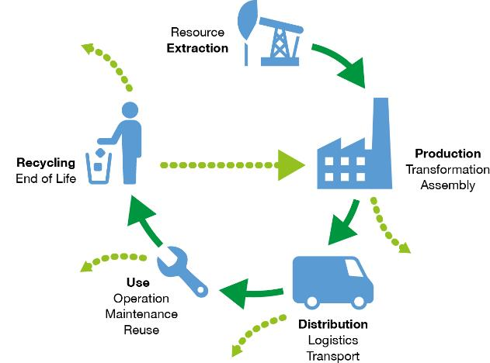
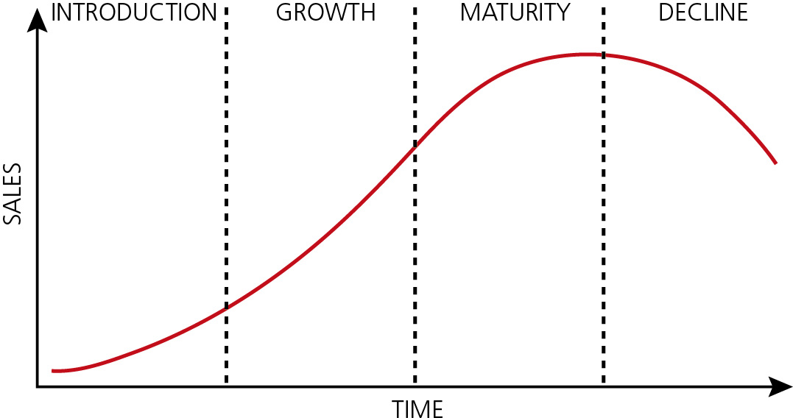
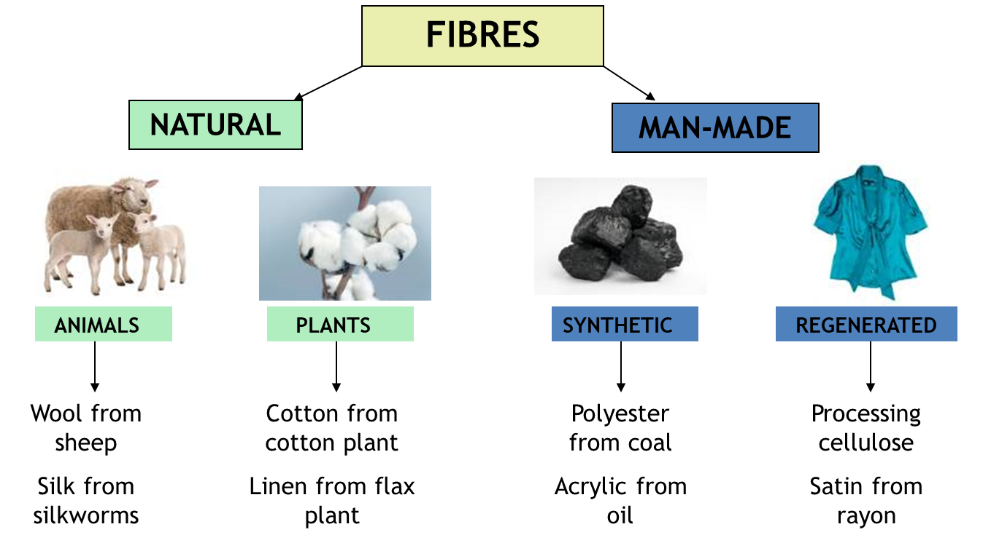
Technology Textiles
Subject: technology food // Knowledge Organiser
HW 4 & 5 - Important vocabulary
Key word | Meaning
1. Lifecycle Analysis | a way to study the impact a product has on the environment from the beginning to the end of its life. The goal of LCA is to find ways to make products in a way that causes less harm to the environment.
2.Sustainability | meeting our own present-day needs without compromising the needs of future generations.
3. Raw Materials | The basic, unprocessed resources extracted from the environment used to manufacture a product.
4. Manufacturing | The process of turning raw materials into finished products through various methods and technologies
5. Usage | The period during which a product is used by consumers, including its performance, maintenance, and energy consumption
6. Disposal | The final stage of a product's lifecycle, involving the end-of-life options such as recycling, composting, landfilling, or incineration.
7. Environmental Impact | The effect a product has on the environment throughout its lifecycle, including resource depletion, pollution, and carbon footprint
8. Product Life Cycle | The stages a product goes through from its creation to its disposal, encompassing introduction, growth, maturity, and decline.
9. Introduction | When the product is launched into the market. This phase involves marketing and promotion to create awareness and attract customers.
10. Growth | The stage where the product's sales start to increase rapidly as more consumers become aware of it and begin to purchase it. This phase often sees improvements and variations of the product.
11.Maturity | The stage where the product's sales growth slows down and stabilizes. The market may become saturated, and competition is intense. Companies focus on differentiation and maintaining market share.
12.Decline | The final stage where the product's sales and popularity begin to fall due to market saturation, technological advancements, or changing consumer preferences. Companies may discontinue the product or innovate to restart the lifecycle.
HW 3 - Important vocabulary
Key word | Meaning
10. 6 R’s | 6Rs: Rethink, Refuse, Reduce, Reuse, Recycle, Repair These are all useful terms to explore reducing the impact of technology on people and the environment.
11.Natural Fibres | Natural fibres come from animals, insects or plants. They all Biodegrade so are sustainable although the processing uses energy.
12.Man-made Fibres | Synthetic fibres, are made from synthetic sources, such as oil, coal or petrochemicals, or naturally sourced materials which undergo a chemical process.

Slide 25
Technology Textiles
Instruction: for each homework, you will be asked to look at a particular section of your Knowledge Organiser to help you answer the questions using full sentences. Each task should take 20 minutes, Set a timer and stop when the time runs out.
Homework 3 ​ |  | Look, write, cover, check vocabulary 10-12. What are the "6 Rs" of sustainability, and why are they important in waste management and resource conservation? Provide an example of how you can "reuse" an item in your daily life instead of throwing it away. Describe the process of "recycling" and how it helps conserve natural resources. Compare and contrast "natural fibres" and "manmade fibres" in terms of their sources and environmental impact.
Homework | Due | Task:
Homework 4 |  | Look, write, cover, check vocabulary 1-7. What is lifecycle analysis, and why is it important in understanding a product's impact on the environment? How do raw materials affect the environmental impact of a product, and why is it important to choose sustainable materials? In what ways can the manufacturing process contribute to a product's overall environmental impact, and what steps can be taken to make manufacturing more eco-friendly? Why is it important to consider the disposal stage of a product's lifecycle, and how can consumers and manufacturers work together to reduce environmental harm at this stage?
Homework 5 ​ |  | Look, write, cover, check vocabulary 8-12. What happens during the introduction stage of a product life cycle, and why is this stage crucial for the product's success? How does the growth stage of a product life cycle differ from the introduction stage, and what are the key indicators of this stage? What strategies might a company use during the maturity stage to maintain its market position and extend the product's life cycle? Why do products eventually enter the decline stage, and what options do companies have to manage this phase of the product life cycle?

Slide 26

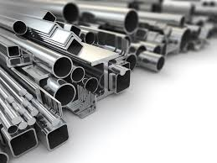
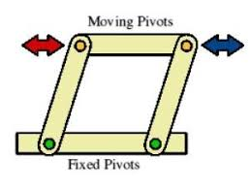
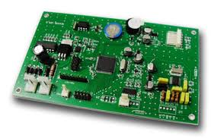
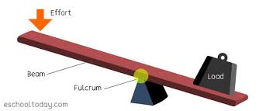
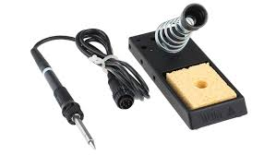
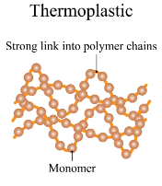
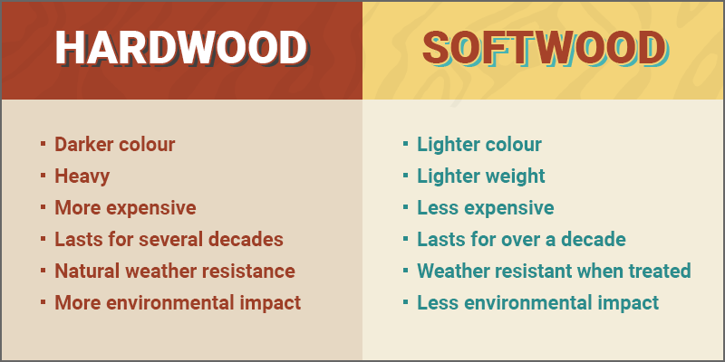
Technology Product Design
Important vocabulary
Key word | Meaning
1. Hardwood | These are usually found in broad-leaved temperate and tropical forests.
2. Softwood | The wood from a conifer (such as pine, fir, or spruce) as distinguished from that of broadleaved trees.
3. Thermoplastic | A plastic that can be reshaped over and over when heat is applied.
4. Thermosetting plastic | A plastic that only be shaped once.
5. Ferrous metals | Ferrous metals refer to any metal that contains iron. They are favoured for their tensile strength and durability
6. Non-ferrous metals | Non-ferrous metals are alloys or metals that do not contain any appreciable amounts of iron. All pure metals are non-ferrous elements, except for iron
7. Soldering iron | A soldering iron is a hand tool that melts solder so two pieces of metal can be joined
8. Printed Circuit Board | An electronic circuit consisting of thin strips of a conducting material such as copper, which have been etched from a layer fixed to a flat insulating sheet
9. Inputs | Electrical or mechanical sensors that use signals from the environment, such as light levels, temperature and pressure
10. Outputs | Devices in electronic systems transform electrical energy into another type of energy, such as light, sound or kinetic energy.
11. Lever | A mechanism that changes an input movement and force into an output movement and force.
12. Linkages | Used in mechanisms to transfer force and can change the direction of movement.

Slide 27
Technology Product
Instruction: for each homework, you will be asked to look at a particular section of your Knowledge Organiser to help you answer the questions using full sentences. Each task should take 20 minutes, Set a timer and stop when the time runs out.
Homework | Due | Task:
Homework 4 ​ |  | Look, write, cover, check vocabulary 1-5. What are some characteristics that differentiate hardwood from softwood, and can you name two examples of hardwood trees? What is the main source of softwood, and what are two common uses for softwood in construction or manufacturing? How does the behaviour of thermoplastic change when heated, and why is this property useful for recycling? What element do ferrous metals contain that makes them prone to rusting, and can you name two examples of ferrous metals?
Homework 5 ​ |  | Look, write, cover, check vocabulary 6-10. What are non-ferrous metals, and can you name three examples commonly used in electronics? What is a soldering iron, and what safety precautions should you take when using one? What is a printed circuit board (PCB), and why is it important in electronic devices? What are inputs in an electronic circuit, and can you give two examples of input devices?

Slide 28
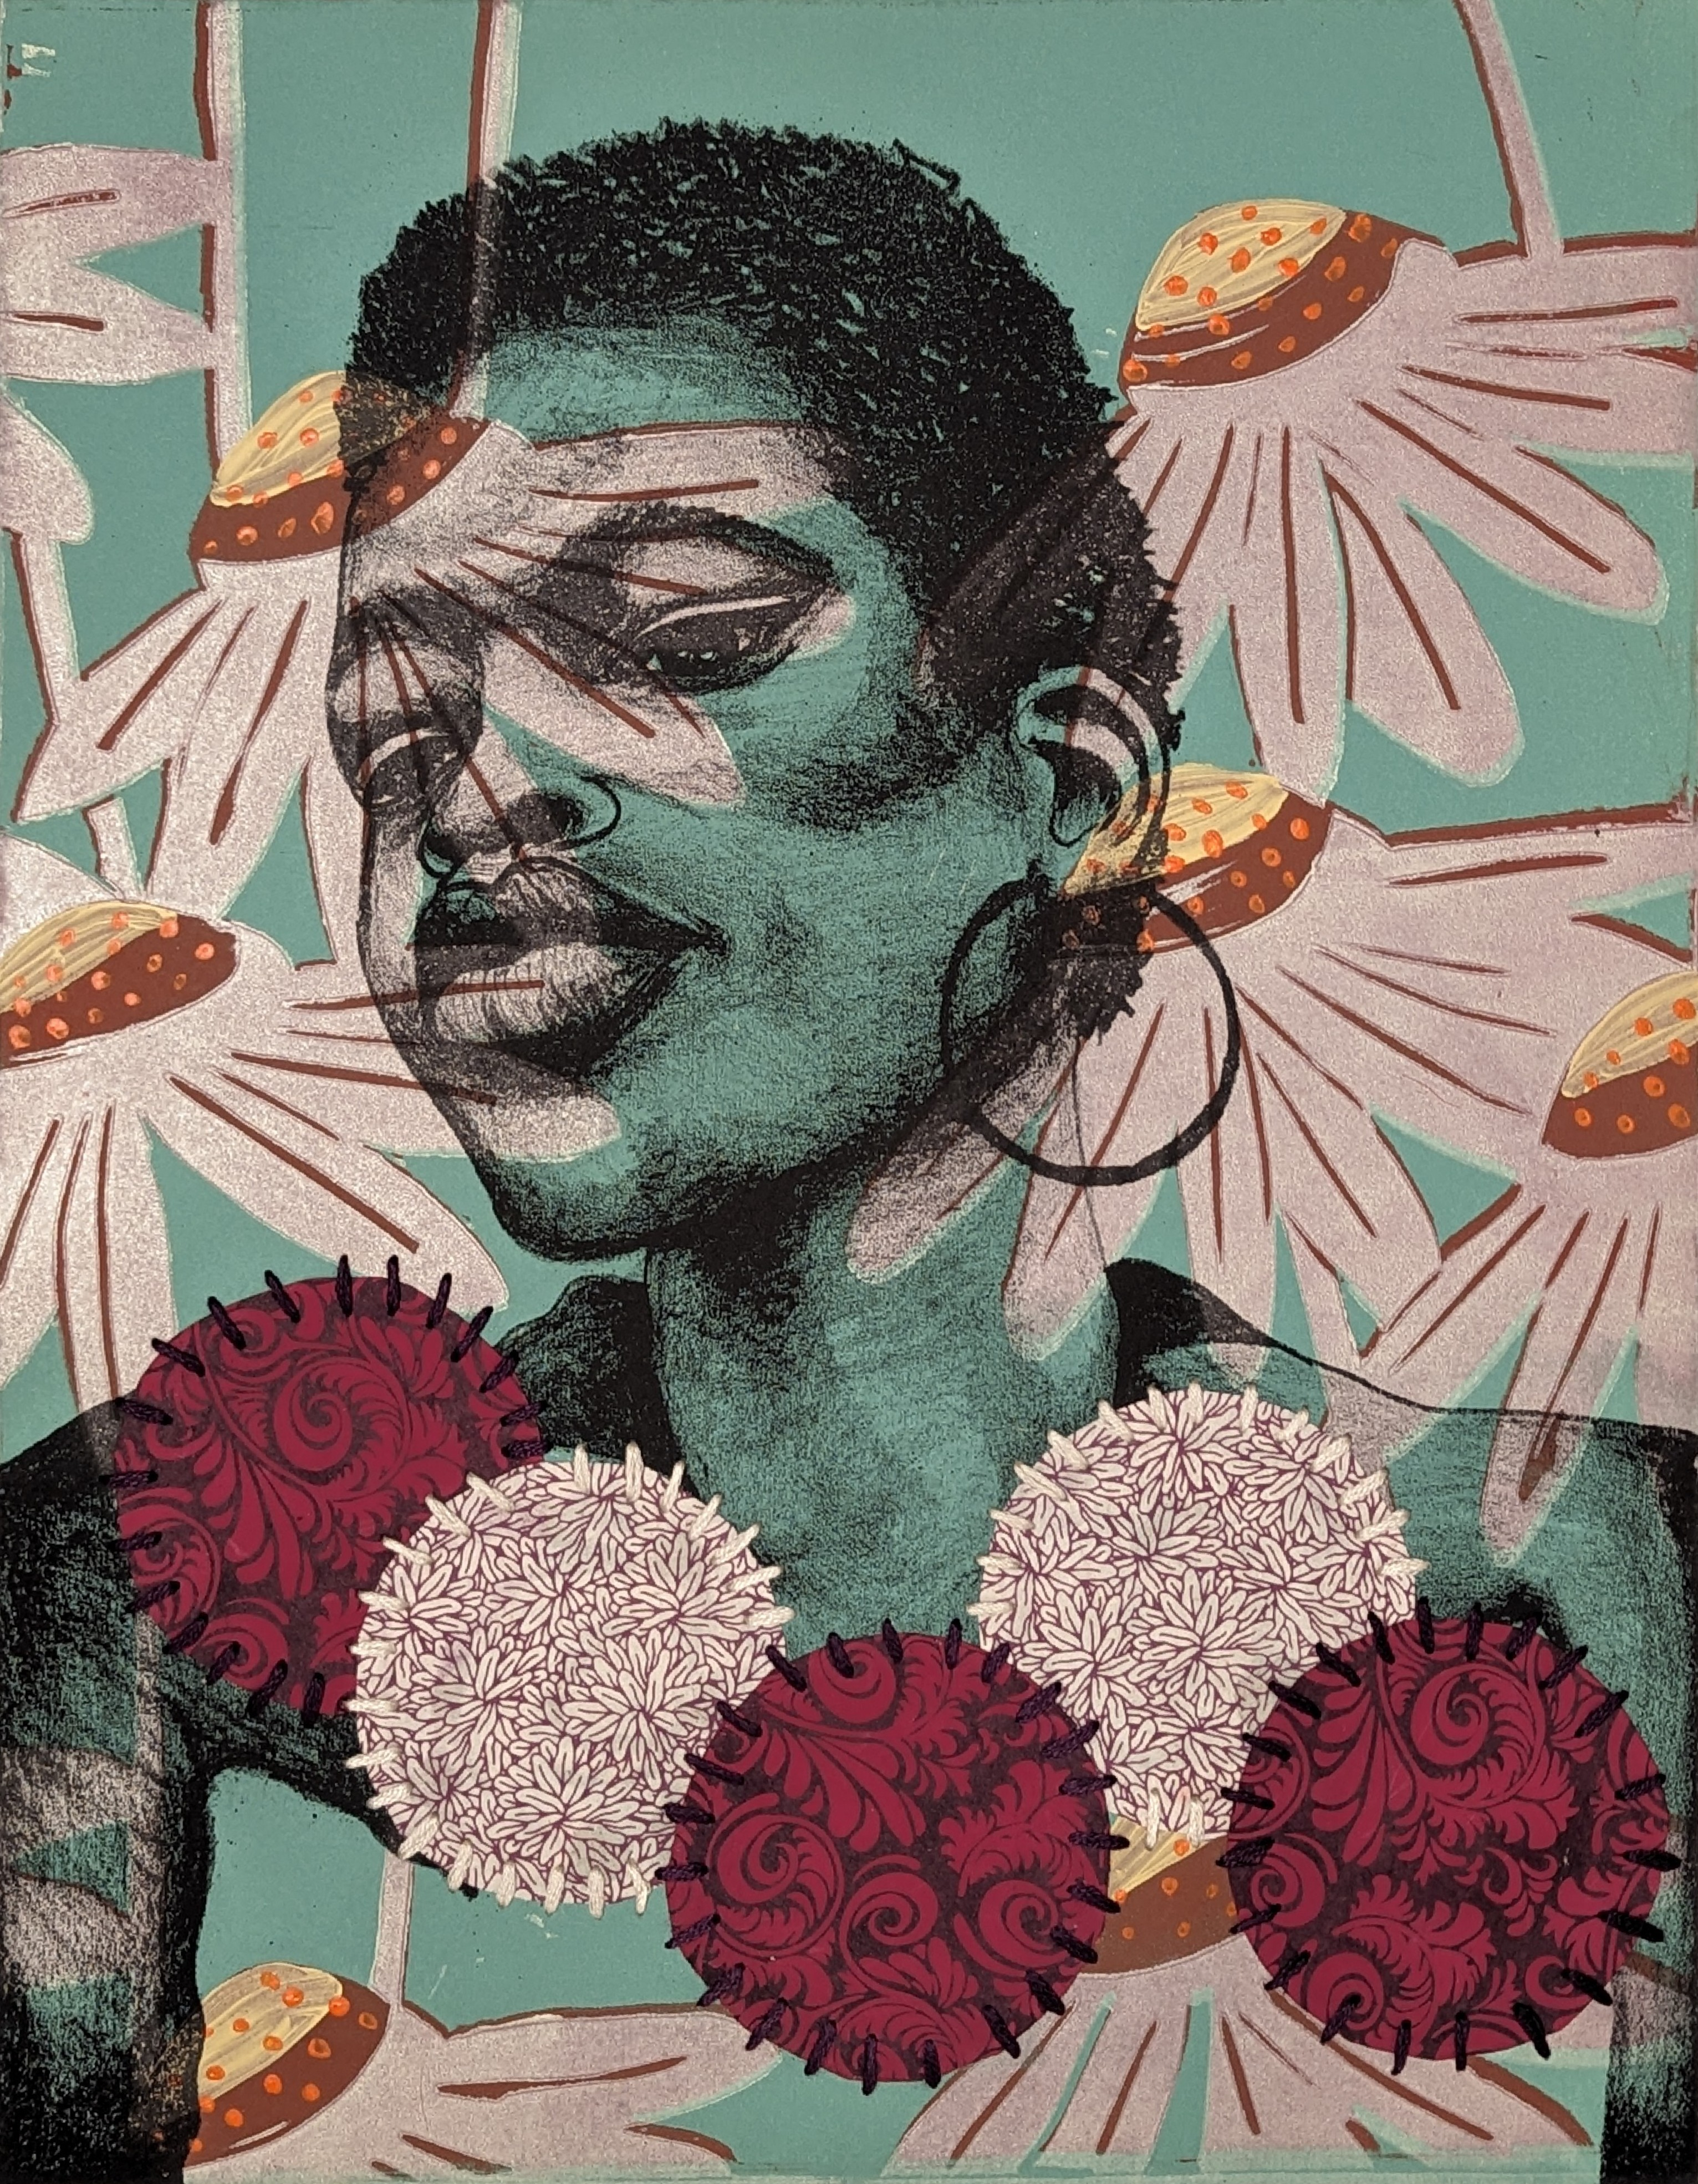
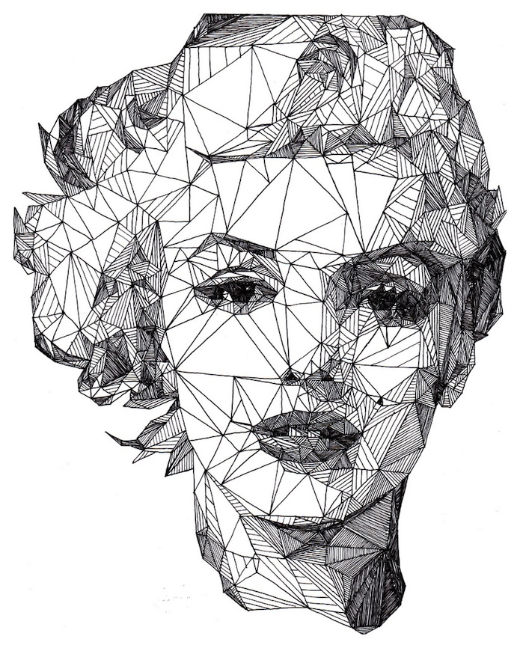
Art
Artist Analysis
1- The piece I am looking at is called…….. (the artworks name) It was made in……….. The artwork measures…….. by………
2- See- Describe the piece of work, imagine you are describing it to someone who cannot see it. You need to add a lot of detail. Subject, Colour, Composition, Tone, Pattern, Texture, Line, Shape/form I can see……………
3- Think- What do you think about the work? I like/dislike this piece because………………..
Delita Martin, Wild Flower. 2018.
Lithograph and screenprint with hand- stitching on paper.
Josh Bryan, Marilyn Monroe, 2013. Fine liner pen on paper.
Notes:
Checked and updated

Slide 29
Art
Instruction: for each homework, you will be asked to look at a particular section of your Knowledge Organiser to help you answer the questions using full sentences. Each task should take 20 minutes, Set a timer and stop when the time runs out.
Homework | Due | Task:
Homework 1 |  | Write a description of the artwork by Delita Martin. Write your opinion about the artwork. Use the sentence starters on the knowledge organiser to help you.
Homework 2 ​ |  | Write a description of the artwork by Josh Bryan Write your opinion about the artwork. Use the sentence starters on the knowledge organiser to help you.
Completed?
Completed?
Notes:
For each homework you will be asked to look at a particular section of your Knowledge Organiser. Set a timer for 20 minutes.
Checked and updated

Slide 30

Drama
Year 9 Drama –Block 12-Section B (Describe, Explain & Evaluate)
Writing Skills
Evaluate | Deciding how successful or unsuccessful the actors were
Describe | Describing what specific vocal or physical skill used e.g. worried facial expressions
Explain | Explaining how they demonstrated the vocal or physical skill e.g. by scrunching their eyebrows together
Analyse | Analysing why they did this, what it showed about the character e.g. this made the character appear concerned about...
You will develop your ability to describe, explain and analyse an extract from your set text using written communication. You will learn how to write structured essays communicating your ideas for staging a piece of scripted dialogue.
Vocal Skills
Pitch | This is how high or low a performer makes their voice when playing different roles. Pitch can show the age, gender and mood of the character.
Accent | This informs the audience what country you are from e.g. England.
Clarity | How clearly you speak.
Volume | This is how loud you speak, this could be from a stage whisper to shouting.
Emphasis | This is when a performer puts extra focus on a word or words within a sentence to make a point, this can be done by elongating, speaking louder or changing the tone of your voice.
Intonation | This is varying your voice so that it goes up and done, this help the fluency of your speech and helps the audience stay engaged with your dialogue.
Projection | This is speaking with strength. Opening your mouth wider creates a bigger projection.
Dialect | A combination of the language used with certain pronunciation that people from a particular area use e.g. Bristolian dialect such as "Gert lush"
Tone | This is showing the mood that your character is feeling e.g. happy, sad, excited, frustrated etc.
Received Pronunciation | This is when you speak with a posh accent, taking care to enunciate each letter in every word. Performers use the front of their mouths when they are delivering their dialogue to give a nasal sound.
Cockney | This is speaking with an East End (London) dialect.
Pronunciation | How you pronounce different words and phrases with use of emphasis and intonation.
Pace | This is how fast or slow a performer speaks. A character who is tired or bored may speak with a slow pace compared with a happy, excited character who will speak with a fast pace.
Pause | A moment of silence inbetween words or lines used for dramatic or comedic effect
Physical Skills
Gesture | A hand action e.g. a wave or a point
Mannerisms | The habits a character has e.g. biting nails
Body Language | Closed or open to show emotion
Facial Expressions | Showing and emotion with the face
Proxemics | The distance between two characters, which tells the audience how they feel about eachother
Gait | The way the character walks
Posture | Are they standing tall and confident, or are they hunched
Eye Contact Eye line | Looking into the eyes of another character Where are they looking with their eyes e.g. the floor
Status | The power dynamic or social hierarchy
Blocking | Where the characters are standing on stage

Slide 31
Drama
Instruction: for each homework, you will be asked to look at a particular section of your Knowledge Organiser to help you answer the questions using full sentences. Each task should take 20 minutes, Set a timer and stop when the time runs out.
Homework | Due | Task:
Homework 1 |  | 1. Look, Write, Cover , Check 5x vocal skills 2. What physical skill could Sephy use to show the emotion of guilty? 3. What vocal skill could Callum use to show frustration? 4. What does the skill ‘evaluate’ mean in written Drama questions? 5. What does skill ‘analyse’ mean in written Drama questions?
Homework 2 ​ |  | 1. Look, Write, Cover , Check 5x physical skills 2. What physical skill could Jude use to show his arrogance when bullying Callum? 3. What vocal skill could Jasmine use to show she had been drinking? 4. What does the skill ‘describe’ mean in written Drama questions? 5. What does the skill ‘explain’ mean in written Drama questions?
Homework 3 ​ |  | 1. Look, Write, Cover , Check 5x elements of play texts 2. Why do you always need to use an adjective or descriptive word when describing physical or vocal skills in a written Drama assessment? 3. When you are analysing the effect on the audience, what word can you mention which describes the mood of the scene? 4. What physical skill can you use to give an example of the characters moving towards or away from eachother? 5. What vocal skill can you describe which shows the character’s emotions?
Completed?
Completed?
Completed?
Notes:
For each homework you will be asked to look at a particular section of your Knowledge Organiser. Set a timer for 20 minutes.

Slide 32
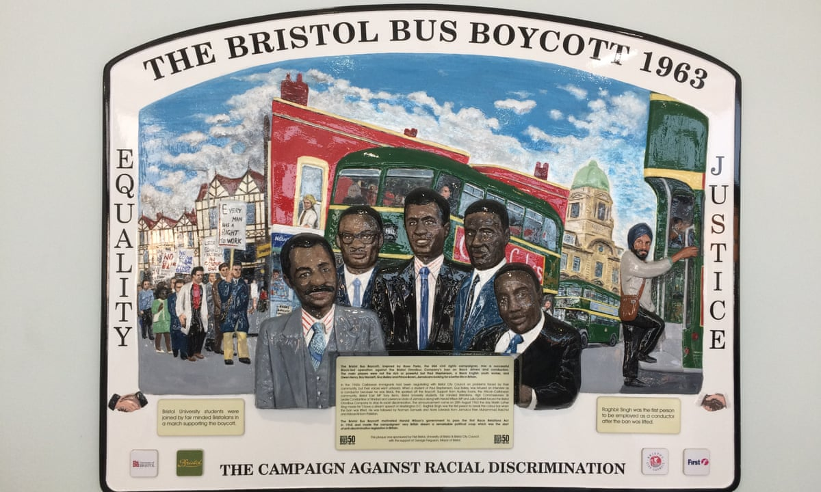
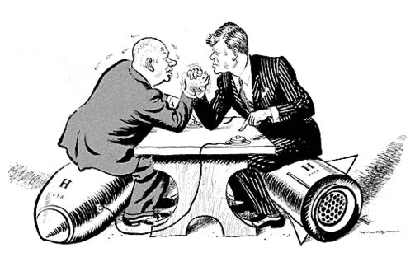
History
Key Term | Definition
1. Cold War | a conflict without fighting between c.1945 and c.1991
2. Capitalism | The political ideology of the USSR e.g. everything should be owned by the government
3. Communism | The political ideology of the USA e.g. individual freedom and the right to vote.
4. Ideology | a set of political ideas/beliefs
5. Boycott | To stop buying or using the goods or services of a certain company or country as a protest.
6. Discrimination | The treatment of a person or group of people, in a way that is worse than the way people are usually treated.
7. Significance | The quality of being worthy of attention; importance.
8. Permissive | Allowing freedom of behaviour.
Women & Young people in the 1960s: During the 1960s women begin to get more opportunities, for example more women are working. Despite this, some stereotypical attitudes existed, for example many believed women shouldn’t work. | The Bristol Bus Boycott: The Bristol bus company refused to hire any people of colour. Students in Bristol refused to use the buses until this rule was changed.
The Cuban Missile Crisis: The USSR had placed nuclear weapons in Cuba. USA did not like this as Cuba was very close to America. | The Space Race: How the USA and USSR were racing to put man on the moon.
The Stonewall Riots: This was the fight in USA for rights for the LGBTQ+ community. It had international impacts. | The Cold War – Conflict between the USA and the USSR. It got its name because there was no direct fighting.
Source 1: Plaque to recognise the Bristol Bus Boycott
Source 2: Cartoon Produced by the Daily Mail (British Newspaper) in 1962
1961
Yuri Gagarin (USSR) becomes the 1st man in space.
1966
England win the World Cup
1969
Man walk on the Moon (USA)
1962
1963
1964
The Bristol Bus Boycott
The Cuban Missile Crisis
USA pass the Civil Rights Act
1969
Stonewall Riots in New York City

Slide 33
History
Instruction: for each homework, you will be asked to look at a particular section of your Knowledge Organiser to help you answer the questions using full sentences. Each task should take 20 minutes, Set a timer and stop when the time runs out.
Homework | Due | Task:
Homework 1 |  | Look, Cover, Write, Check: Terms 1, 2 and 3. What happened in 1961? Why do you think this was an important event? What was the Cuban Missile Crisis? What can you see in Source 2 (list at least 5 things).
Homework 2 ​ |  | Look, Cover, Write, Check: Terms 4, 5 and 6. What is the difference between Communism and Capitalism? What was the Bristol Bus Boycott? Look at source 1, how useful is this source for finding out about the Bristol Bus Boycott? Source 1 is a plague, what other sources could you use to find out about the Bristol Bus Boycott?
Homework 3 ​ |  | Look, Cover, Write, Check: Terms 7 and 8. How does a historian decide whether a historical event is significant? (Can you remember any of the ‘R’s?) Why do you think American and the USSR took part in the space race? Looking at the timeline, which event do you think was the most significant and why? Why was the Cold War, called the Cold War?
Completed?
Completed?
Completed?
Notes:
For each homework you will be asked to look at a particular section of your Knowledge Organiser. Set a timer for 20 minutes.

Slide 34
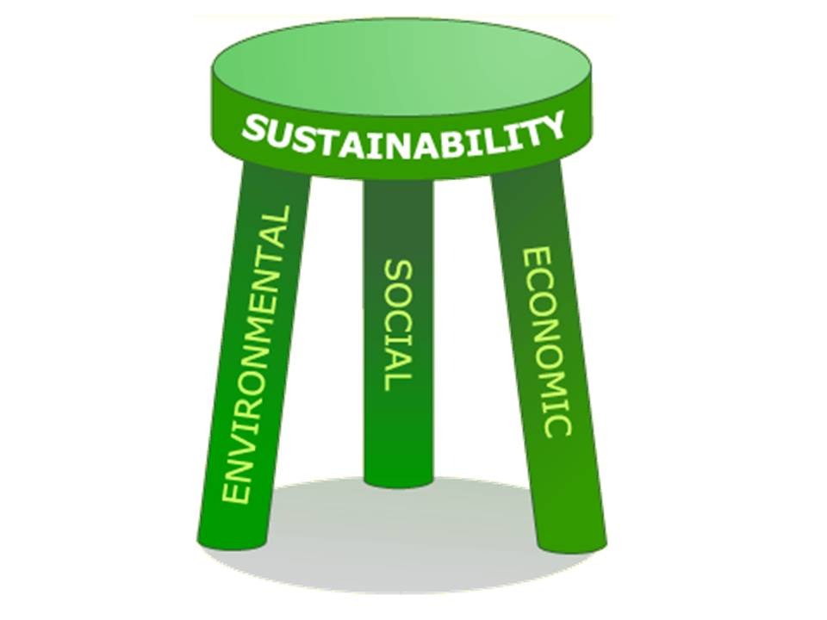





Geography
9.5 How can we become sustainable citizens?
Keyword | Definition
1. Carbon Footprint | The amount of carbon dioxide released into the atmosphere by a person or organisation.
2. Economic Sustainability | Practices that support long-term economic growth without negatively impacting social, environmental, and cultural aspects of the community.
3. Environmental Sustainability | The practice of interacting with the planet responsibly.
4. Grey water Recycling | Uses existing plumbing in your home to recycle old water for new uses.
5. Sustainability | When materials and resources are used in a way that will balance the needs of the present without compromising the future.
6. Sustainable Development Goals | A collection of 17 interlinked global goals designed to be a "blueprint to achieve a better and more sustainable future for all“.
7. Social Sustainability | When materials and resources are used in a way that will balance the needs of the present without compromising the future people.
We can split sustainability into three different categories:
Social
Economic
Environmental
This is known as the stool of sustainability.
What are the global responses to sustainability?
In 2015, the UN member states agreed to 17 Global Goals (the SDGs).
These goals have the power to create a better world by 2030, by ending poverty, fighting inequality and addressing the urgency of climate change.
Guided by the goals, it is now up to all of us, governments, businesses, civil society and the general public to work together to build a better future for everyone.

Slide 35
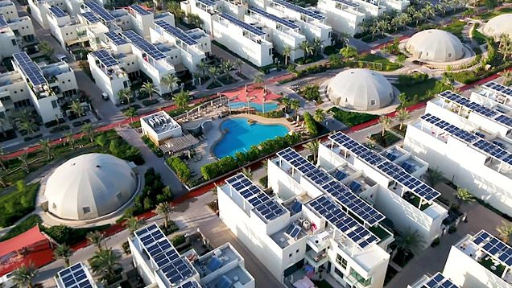
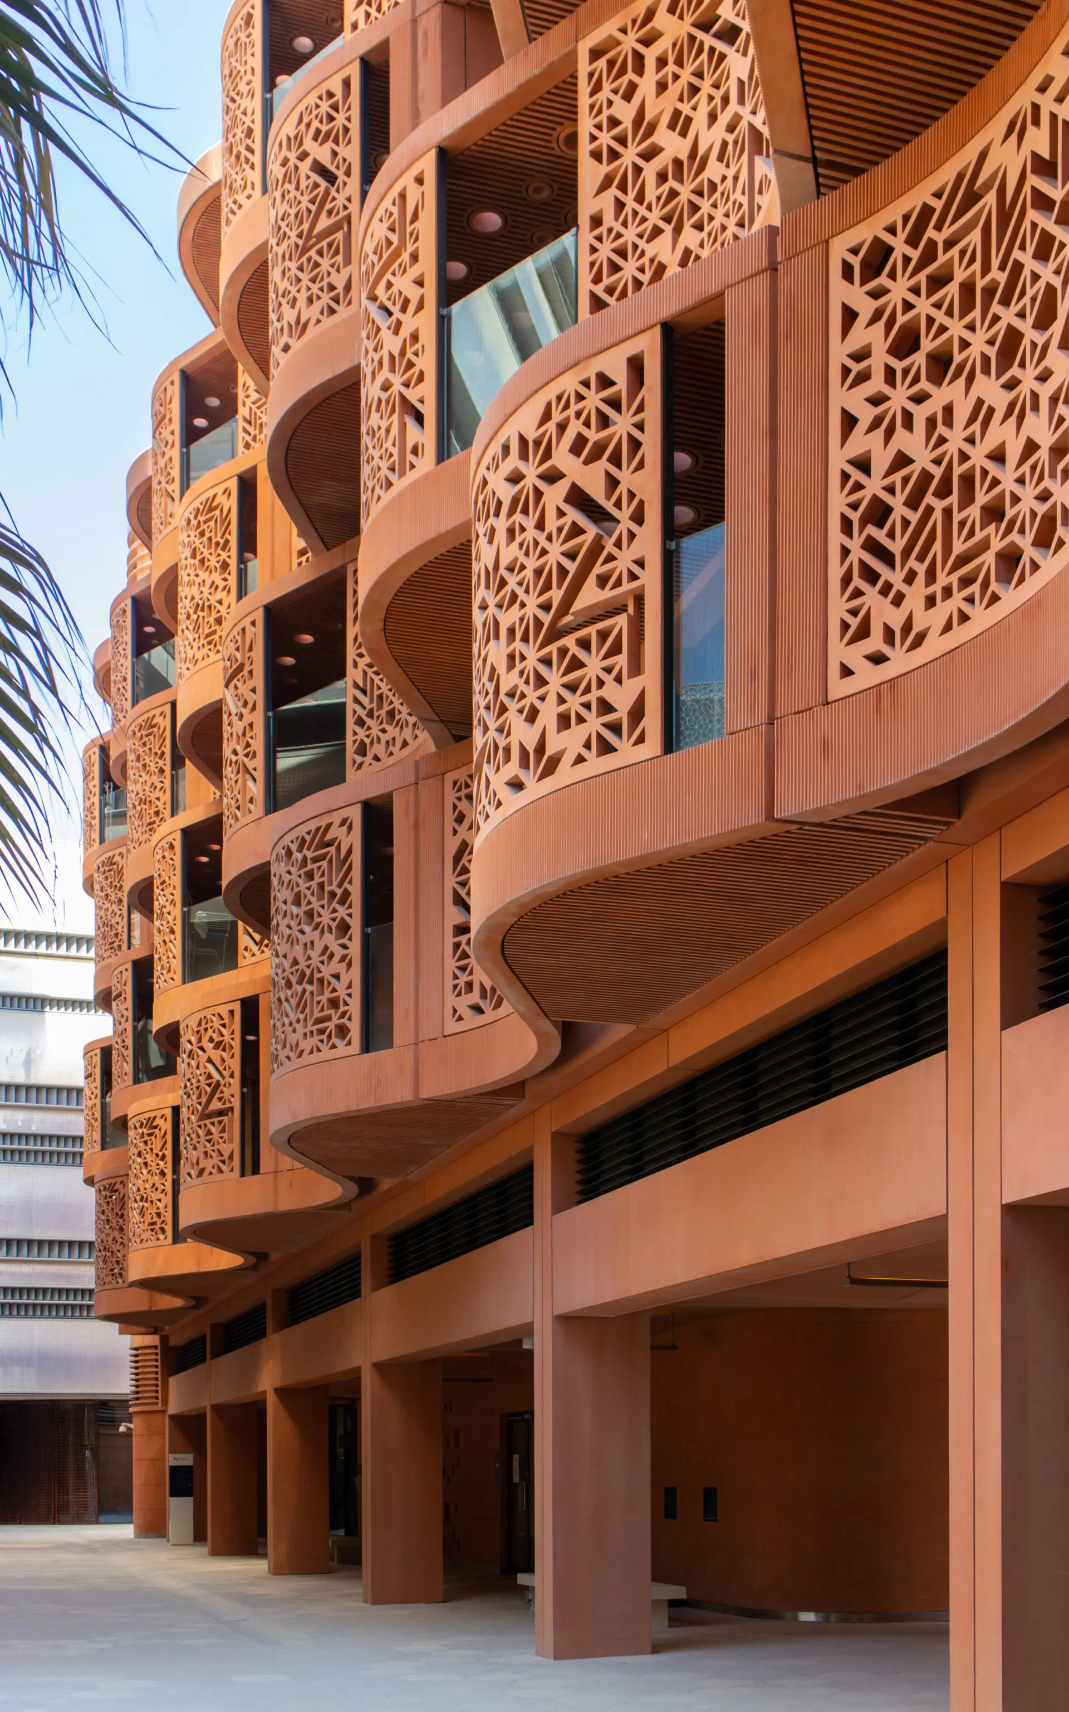
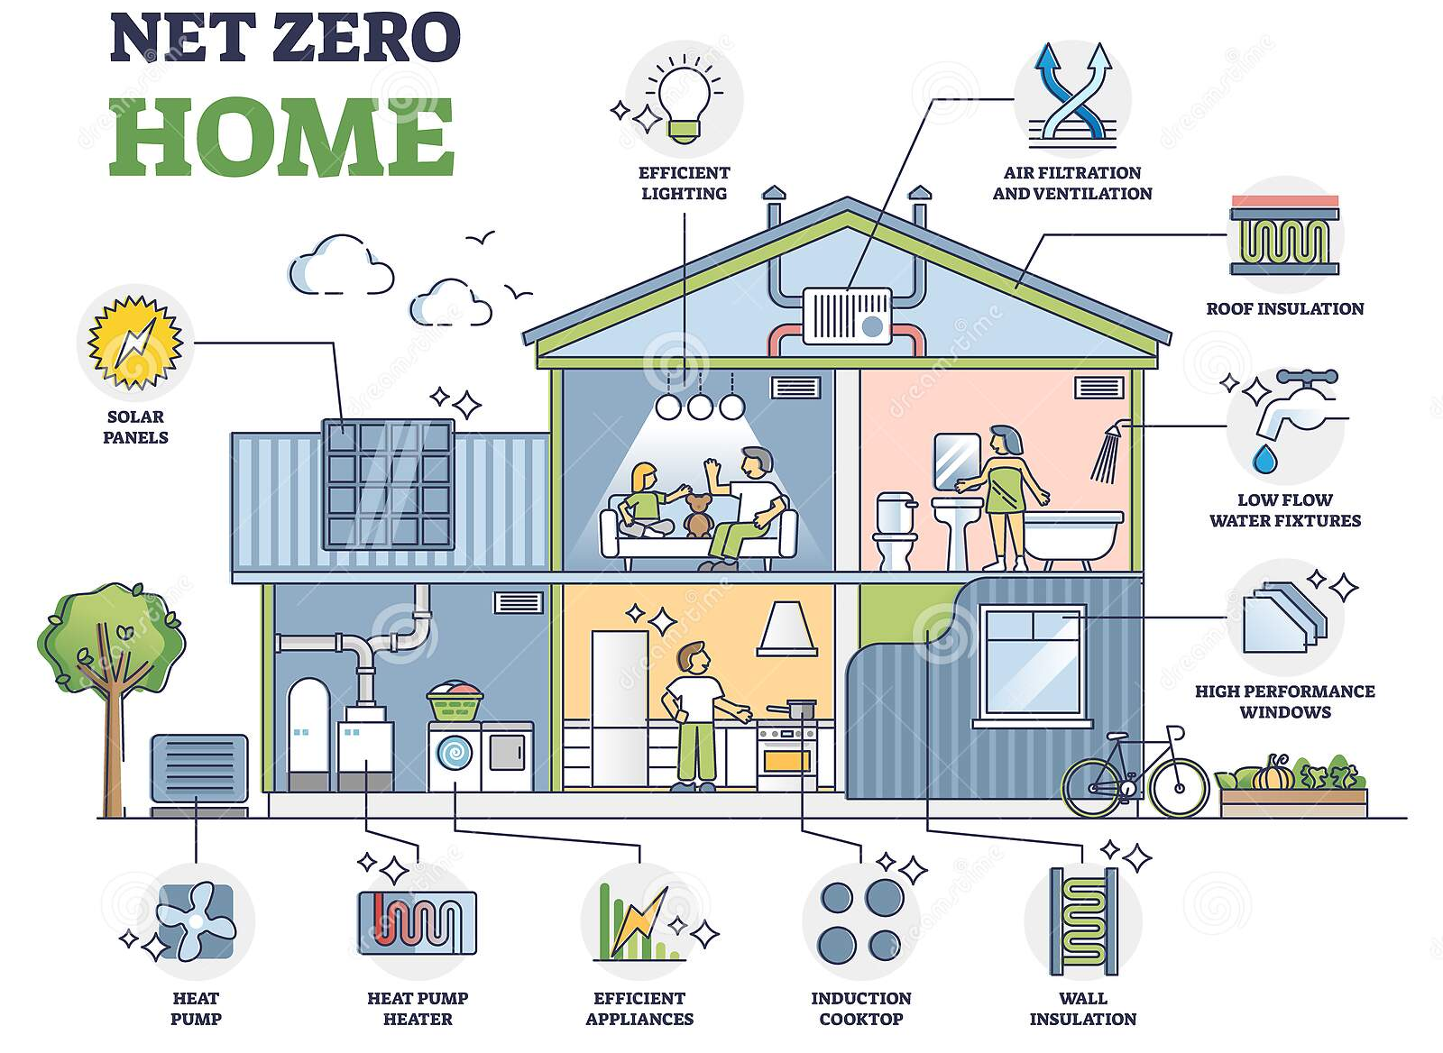
Geography
How can cities become sustainable?
Social | Economic | Environmental
Safe for children as cars have to be kept on the outside of the city. Community swimming pool that is free to use. Residents can get jobs working in the bio-domes growing food. | Residents are given $10,000 to buy an electric car. Lots of investment from other businesses. No service fees. | Low Carbon development. Solar panels on the top of every house and the car parks. Grey water recycling for irrigation of crops. Urban farms Houses face north to be in the shade and reduce use of air con. UV reflective paint.
Started in 2006, Masdar City in Abu Dhabi in the UAE is set to be completed by 2025.
How can homes become sustainable?
How can we become more sustainable?
Eat locally grown produce, reducing our food miles (the miles food is transported over).
Use more sustainable fashion brands.
Use more public transport/ cycle or walk more to reduce our reliance on fossil fuels.
Turn off our appliances instead of leaving them on standby.
Reduce, reuse, recycle.
Use more renewable energy resources.

Slide 36
Geography
Instruction: for each homework, you will be asked to look at a particular section of your Knowledge Organiser to help you answer the questions using full sentences. Each task should take 20 minutes, Set a timer and stop when the time runs out.
Homework | Due | Task:
Homework 1 |  | Look, cover, write and check key words 1-3. What is the stool of sustainability? Name three sustainable development goals. What is the aim of the sustainable development goals? Complete the sentence: The sustainable development goals are important because….
Homework 2 ​ |  | Look, cover, write and check key words 4-5. How many years is the Masdar City project going to take to complete? Name two economic ways in which the city is becoming sustainable. Explain why using renewable energy is important in achieving environmental sustainability. Which is the most important aspect of sustainability within Masdar City? Explain your answer.
Homework 3 ​ |  | 1. Look, cover, write and check key words 6-7. Name two ways in which a house can be made sustainable. What are food miles? Why is it important to reduce them? How can you as an individual be sustainable?
Completed?
Completed?
Completed?
Notes:
For each homework you will be asked to look at a particular section of your Knowledge Organiser. Set a timer for 20 minutes.

Slide 37
RE
Changemakers: How does belief inspire change?
Keywords
1. Activism | The use of action to bring about change
2. Civil Rights | Political and social equality and freedom
3. Civil Disobedience | Refusal to comply with certain laws
4. Democracy | A publicly elected government
5. Racism | To discriminate against people of a certain race
6. Equality | A state of being equal
7. Social Justice | Fair distribution of wealth and rights in a society
8. Prejudice | Prejudged opinions of a person or group.
9. Discrimination | Unfair treatment of a group
10. Conviction | A firmly held belief or opinion
11. Marginalised | Individuals or groups who are excluded from mainstream society
12. March on Washington | The historic civil rights march on Washington D.C. on August 28, 1963, where Martin Luther King Jr. delivered his famous "I Have a Dream" speech.
13. LGBTQ+ rights | Equal rights and protections of LGBTQIA+ individuals
What is activism? The word "activism" is only about 100 years old, at least in its current use, and derives from the verb to act. An activist is someone who is active in campaigning for change, normally on political or social issues. Activism is what activists do, that is, the methods they use in order to bring about change. Human rights activism is thus about reacting to injustice, to abusive treatment, to violence or discrimination, and trying to correct it.
Christian views on prejudice and discrimination Christians believe that all humans are made in the image of God. Therefore any action that devalues a person is an insult to God who created and loves that person: ‘Love your neighbour as yourself.’ - Matthew 22:39
Examples of Activism
Demonstrations and protests | During a demonstration or a protest, people united by a common belief meet together. They might march along a specific route, sit in at a specific place to draw attention to the cause, or hold a vigil to honour someone’s life
Boycotts | to refuse to buy a product or take part in an activity as a way of expressing strong disapproval
Strikes | When workers deal with unfair or dangerous work conditions, low wages, or other issues, they might refuse to work when negotiations are refused or they fail.
Social media campaigns | Also known as “hashtag activism,” it brings activism to social media networks like Instagram and Twitter. Users raise awareness of issues, organizations, and actions through posts, graphics, videos, and more.
Islamic views on prejudice and discrimination Islam teaches that God created everyone as equal but different. As all are created by God, discrimination against any human is unjustified. The ummah crosses all gender, race and wealth boundaries: “All human beings are equal like the teeth of a comb.” - Hadith
Social Justice – Malcolm X Malcolm X was an important leader who fought against racism and worked to empower Black people in the United States. He believed that Black people should have control over their own lives and communities, and he criticized the way that mainstream civil rights leaders were approaching the issue. He contributed to social justice by: Promoting Black independence and challenging the idea of white superiority. Advocating for Black economic and political power through initiatives such as Black nationalism and separatism. Highlighting the impact of systemic racism and institutional discrimination on the Black community.

Slide 38
RE
Racism– Martin Luther King Jr Martin Luther King Jr. was a famous civil rights leader who fought for racial equality and social justice in the United States during the mid-20th century.
Influence of Beliefs: Christian beliefs strongly influenced his activism and his vision for social justice. He saw the struggle for civil rights as a moral issue, and he believed that all people were created equal in the eyes of God. He emphasised the importance of love and nonviolence in the struggle for justice, drawing on Jesus' teachings in the New Testament. | Contributions to change Advocating for nonviolent protests to challenge racial discrimination and segregation. Leading the Montgomery Bus Boycott and the March on Washington, which brought national attention to the Civil Rights movement. Promoting racial equality and the end of segregation through the Civil Rights Act of 1964 and the Voting Rights Act of 1965.
Education – Malala Yousafzai Malala Yousafzai is a Pakistani education activist who has become a prominent voice for girls' education and women's rights.
Influence of Beliefs: Malala Yousafzai is a Muslim, and her faith has played a significant role in inspiring her activism for girls' education and women's rights. She drew on the example of Prophet Muhammad, who taught that seeking knowledge was a duty for both men and women, to inspire her own advocacy for girls' education. | Contributions to change Advocating for girls' education in Pakistan. Co-founding the Malala Fund to promote girls' education around the world Speaking out on a variety of global issues, including refugees, climate change, and social justice.
LGBTQI+ – Marsha P Johnson Marsha P. Johnson was a Black transgender woman and LGBTQ+ rights activist who fought for justice and equality for marginalized communities.
Contributions to change Being a prominent figure in the Stonewall uprising of 1969, which is widely considered a turning point in the fight for LGBTQ+ rights Co-founding the Street Transvestite Action Revolutionaries (STAR) which provided housing and support to homeless transgender youth. Challenging traditional gender norms. Promoting the idea that all people should be free to express their true selves. | Impact on religion: Marsha P. Johnson's legacy has inspired many religious communities to re-examine their traditional teachings on gender and sexuality. Some religious organizations have even begun to recognize and celebrate the lives of LGBTQ+ figures like Marsha P. Johnson as part of their own religious traditions, highlighting the intersections between faith and social justice.
Christian views on Activism Many Christians believe that they are called to work for justice and to serve others, based on the teachings of Jesus Christ. They see activism as a way to live out their faith and to make a positive impact in the world. This can take many different forms, including political advocacy, social justice work, and community service. Many Christians believe in the importance of prayer, worship, and spiritual reflection to sustain their activism and to remain connected to God's guidance and wisdom. Activism is a part of a larger spiritual journey; they believe that their faith can provide strength and inspiration for their work.
Islamic views on Activism The concept of social justice is central, and Muslims believe that they have a responsibility to work for the betterment of society and to alleviate the suffering of those in need. This can take many forms, including political activism, social welfare work, and community service. Muslims also believe in the importance of prayer and worship to connect with God and to seek guidance and inspiration for their work. They see activism as a way to live out the principles of their faith and to embody the teachings of the Prophet Muhammad.

Slide 39
RE
Instruction: for each homework, you will be asked to look at a particular section of your Knowledge Organiser to help you answer the questions using full sentences. Each task should take 20 minutes, Set a timer and stop when the time runs out.
Homework | Due | Task:
Homework 1 |  | Look, cover, write and check key words 1-4. Give two examples of activism. Give one difference in the Islamic and Christian views on prejudice and discrimination. How can groups use social media in their activism? Why might organising a boycott be an effective way to protest for change?
Homework 2 ​ |  | Look, cover, write and check key words 5-9. Who was Malcolm x? What did he believe? Give two examples of his activism work. What is the difference between prejudice and discrimination?
Homework 3 ​ |  | Look, cover, write and check key words 10-13. Who was Martin Luther King Jr? How did his Christian belief influence his activism? Give two examples of his activism work? What do Islam and Christianity say about activism?
Completed?
Completed?
Completed?
Notes:
For each homework you will be asked to look at a particular section of your Knowledge Organiser. Set a timer for 20 minutes.

Slide 40























French
Quelle est ta matière préférée? | What is your favourite subject?
L’anglais | English
L’espagnol | Spanish
Le français / les langues | French / languages
Le théâtre | Drama
Le dessin | Art
Le sport (L’EPS) | P.E.
L’informatique | I.C.T.
La musique | Music
La technologie | D.T.
La géographie | Geography
L’histoire | History
La religion | R.S. (Religious Studies)
L’éducation civique | P.S.H.E
Les mathématiques | Maths
Les sciences | Science
Qu’est-ce que tu en penses? | What do you think of it?
C’est/Ce n’est pas | It is/It is not
Intéressant (e) | Interesting
Pratique | Practical
Utile/inutile | Useful/not useful
Facile/Difficile | Easy/difficult
Ennuyeux (se) /barbant (e) | Boring
Passionnant (e) | Exciting
Créatif (ve) | Creative
Important (e) | Important
Trop | Too
Très | Very
Assez | Quite
Un peu | A bit (a little)
du tout | At all
Comment est ton uniforme scolaire? | What is your school uniform like?
Je porte | I wear
Il faut porter | You must wear
Une veste | A blazer/jacket
Un pull | A jumper
Une chemise | A shirt
Une cravate | A tie
Une jupe | A skirt
Des chaussettes | Socks
Un pantalon | Trousers
Des chaussures | Shoes
Un collant | Tights
Un hijab | Hijab
Moche | Ugly
Beau/belle | Beautiful
(In)confortable | (un)comfortable
Cher | Expensive
Pas cher/bon marché | Not expensive/cheap
À la mode | Fashionable
Démodé(e) | Old-fashioned
Qu’est-ce que tu voudrais faire dans le futur? | What would you like to do in the future?
Je vais | I am going
Je voudrais/J’aimerais | I would like
Réussir mes examens | To pass my exams
Recevoir des bonnes notes | To get good results
Faire un apprentissage | To do an apprenticeship
Chercher du travail | To search for a job
Faire du bénévolat | To do voluntary work
Voyager autour du monde | To travel the world
Avoir des enfants/me marier | To have children/marry
Apprendre à conduire | To learn to drive
Devenir | To become
Médecin/Veterinaire | A doctor/a vet
Professeur/Avocat(e) | A teacher/a lawyer
Mécanicien(ne)/Plombier | A mechanic/a plumber
Pompier (ière) | A firefighter
Coiffeur(euse) | A hairdresser
Quelles sont les règles? | What are the rules?
On doit / On ne doit pas | You must / You must not
On peut / On ne peut pas | You can / You can not
Il faut | You must
Il est interdit de/d’ | It is forbidden to
Écouter en classe | (to) listen in class
Utiliser son portable en classe | (to) use your phone in class
Porter des bijoux | (to) wear jewellery
Porter du maquillage | (to) wear make-up
Porter des baskets | (to) wear trainers
Manquer les cours | (to) miss lessons
Être à l’heure | (to) be on time
Mâcher du chewing-gum | (to) chew chewing-gum
Faire ses devoirs | (to) do homework
La journée scolaire | The school day
Je quitte la maison | I leave the house
Je vais au collège | I go to school
Les cours commencent à | Lessons start at
Les cours terminent à | Lessons end at
Ça dure | It lasts
La récréation | Breaktime
L’heure du déjeuner | Lunchtime
Le matin | The morning
L’après-midi | The afternoon
Le soir | The evening
Un élève | A pupil

Slide 41
French
The future tense in French
You can talk about the future by using the near future tense.
Use part of the verb ALLER and the infinitive to say what you are going to do.
Ce soir, je vais jouer au tennis. This evening I am going to play tennis.
Demain, Paul va faire un gâteau. Tomorrow Paul is going to make a cake.
You can also use the following phrases with an infinitive to refer to the future.
Je veux= I want
Je voudrais = I would like
J’aimerais = I would like
J’espère = I hope
J'ai l'intention de = I intend / I am planning
9.11 My school
Knowledge Organiser
​The present tense | ER verb ​ | IR verb​ | RE verb​
Je (I)​ | -e​ | -is | -s
tu (you)​ | -es​ | -is | -s​
Il/Elle/On (he/she/one) ​ | e | -it | -
Nous (we)​ | -ons | -issons | -ons
Vous (you all)​ | -ez | -issez​ | - ez
Ils /Elles (they) ​ | -ent​ | -issent | -ent​
Adjectives describe nouns e.g., a black blazer.
In French, adjectives normally go after the words they are describing e.g., une chemise bleue (a blue shirt) and they must agree with the noun they are describing.
Adjectives must agree with the noun (or pronoun) they describe in gender and in number.
This means that if the noun an adjective describes is feminine, the adjective must be feminine e.g., une veste noire (a black blazer).
If that same noun is also plural, the adjective will be feminine AND plural as well e.g., les chaussettes noires (black socks).
Comparatives – to express more or less than
… est plus + adjective + que - is more…adjective…than
… est moins + adjective + que - is less…adjective… than
… est aussi + adjective + que – is as…adjective…as
For example:
L’anglais est plus intéressant que la géographie. (English is more interesting than Geography)
L’histoire est moins amusant que l’E.P.S. (History is less fun than PE)
Le français est aussi difficile que les maths. (French is as difficult as maths).

Slide 42



















French
¿Quelle est ta fête préférée? | What is your favourite festival
Ma fête préférée est… | My favourite festival is..
Le Noël | Christmas
La veille de Noël | Christmas Eve
La Saint-Sylvestre | New Year’s Eve
Le nouvel An | New Year’s Day
Le Divali | Divali
Pâques | Easter
Le Hanoukka | Hanukkah
L’Aïd | Eid
Le premier avril | April Fool’s day
L’anniversaire | Birthday
Le premier mai | May day
Une fête | Party
La fête des Mères | Mother’s day
La fête de la musique | Music festival
Un jour férié | Bank Holiday
Le mariage/les noces | Marriage/wedding
Le 14 juillet | Bastille Day
La Saint-Valentin | Valentine’s day
Le Mardi Gras | Shrove Tuesday
¿Qu’est-ce qu’on fait pour célébrer? | What do we do to celebrate?
Je me lève | I get up
Je me douche | I shower
Je m’habille | I get dressed
Je reçois des cadeaux/du muguet | I receive presents/lily of the valley
J’éteins des bougies | I blow candles out
Je décore l’arbre de Noël | I decorate the Christmas tree
J’achète des nouveaux vêtements | I buy new clothes
Je vais à l’église Je vais à la mosquée Je vais à la place Je vais à la maison de … | I go to church I go to the mosque I go to the square I go to …’s house
… arrive | … arrives
Nous mangeons… | We eat…
Nous jeûnons | We fast
Nous jouons des jeux de société | We play board games
Nous célébrons | We celebrate
Je m’amuse bien | I have a good time
Je regarde des feux d’artifices | I watch the fireworks
Je vais au lit | I go to bed
Je me couche | I go to sleep
Les phrases/verbes du passé | Phrases/verbs in the past
L’année dernière | Last year
Le mois dernier | Last month
Avant hier | The day before yesterday
La semaine dernière | Last week
Hier | Yesterday
Dans le passé | In the past
Quand j’avais … ans | When I was … years old
L’été dernier | Last summer
L’hiver dernier | Last winter
Il y a … (deux ans) | … ago (two years)
Le weekend dernier | Last weekend
Je suis allé(e) | I went
J’ai célébré | I celebrated
J’ai mangé | I ate
J’ai bu | I drank
J’ai ouvert | I opened
C’était | It was
Les phrases/verbes du futur | Phrases/verbs in the future
L’année prochaine | Next year
Le mois prochain | Next month
Après demain | The day after tomorrow
Demain | Tomorrow
La semaine prochaine | Next week
Dans le futur / à l’avenir | In the future
Quand j’aurais … ans | When I will be … years old
L’été prochain | Next summer
Je vais aller | I am going to go
Je vais célébrer | I am going to celebrate
J’ai l’intention de manger | I intend to eat
Je voudrais/j’aimerais boire | I would like to drink
C’est comment? | How is it like?
passionnant | Exciting
inoubliable | unforgetable
amusant | Fun
insupportable | Unbearable
Un désastre | A disaster

Slide 43
French
9.12 Festivals and Culture
Reading – Top tips
• Read the introduction to the question carefully. This will help you to give sensible answers. Look for titles.
• Answer every question, especially where you have to write a letter. If in doubt, have a guess.
• Read the whole of the sentence so that you can check that your first reaction is right. If you think the answer is ‘P’ (positive) for example, read on in the text to make sure that the correct answer is not in fact ‘P and N’ (positive and negative).
• Do not copy whole chunks of the text because you might include the wrong answer as well as the right answer.
• If you are asked to give one reason or one detail, only give one.
VOCABULARY IS KEY!
Look through the vocab lists and try to refresh your memory of as much vocabulary as possible.
Listening check-list
Before I listen …
1. read the exercise carefully, paying attention to the instructions and pictures
2. think of possible words, phrases and ideas I might hear
3. think about how these words and phrases would be pronounced
4. think of the different ways certain phrases could be expressed
While I listen, pay attention to…
5. repetition or paraphrase
6. time marker phrases
7. the questions and tasks that go with the passage
8. all the things I predicted (questions, vocabulary, possible answers)
While I listen, I work out any words I don’t know by…
9. using the words I understand to get the general meaning of the passage first
10. listening to words that come before or after the unknown word
11. using my general knowledge to think about what the unknown word might logically mean
12. listening to what comes later in the passage for further clues, or to check whether the unknown word does in fact mean what I think it means
13. using what I know about sentence structure to work out what kind of word it is (noun, adjective, verb)
14. thinking whether the unknown word is like a word I know in English or French/German/Spanish, and then checking whether that meaning would make sense
Translation – Top tips
Read the whole sentence/paragraph first.
Chunk the sentences e.g. I play / videogames / in my bedroom.
Highlight what you don’t know.
Be as ACCURATE as you can.
What are you being tested on, look out for different time markers.
Make sure you reread your translation, does it make sense?

Slide 44
French
Instruction: for each homework, you will be asked to look at a particular section of your Knowledge Organiser to help you answer the questions using full sentences. Each task should take 20 minutes, Set a timer and stop when the time runs out.
Homework | Due | Task:
Homework 1 |  | 1. Follow the ‘look, cover, write, check, repeat’ method with the following vocabulary items: Je voudrais, j'aimerais, réussir, me marier, devenir 2. What are the three different infinitive verb endings in French? 3. Translate the adjectives below into English : Pratique, intéressant, créatif, passionant, facile 4. Which of these sentences is NOT the future tense? (a) Je vais voyager avec ma famille après mes examens (b) Normalement je voyage avec ma famille (c)Je voudrais voyager avec ma famille après mes examens 5. Fill out the below adding the correct part of aller for each pronoun Je ____, tu ____, il ____, elle ____, on _____, nous ______, vous ______, ils ______, elles _______
Homework 2 ​ |  | 1 Follow the ‘look, cover, write, check, repeat’ method with the following vocabulary items: Le Noël, Le nouvel An, Pâques, L’Aïd, une fête 2. Is this statement true or false? Je voudrais, j'aimerais and j'ai l'intention de all refer to the future tense. 3. Read these two French sentences. Can you explain why there are two different endings to the adjective? Une fête amusante Un festival amusant 4. Are the below sentences present or future tense? Write P or F Normalement, je vais en France pour Noël L'année prochaine je vais rester en Angleterre pour Noël 5. Can you spot the x3 errors and correct them? Normalment, pour les vacances d’Aïd je rester avec ma famille et on manger ensemble.
Notes:
For each homework you will be asked to look at a particular section of your Knowledge Organiser. Set a timer for 20 minutes.

Slide 45
French
For each homework, you will be asked to look at a particular section of your Knowledge Organiser. Each task should take 20 minutes, Set a timer and stop when the time runs out.
Homework | Due | Task:
Homework 3 ​ |  | Follow the ‘look, cover, write, check, repeat’ method with the following vocabulary items: Le Hanoukka, l’anniversaire, un jour férié, le mariage, La Saint-Valentin 2. Complete the sentence : In French to say what you are going to do (the future tense) you need part of the verb _______ + the _____________ 3. What are 3 strategies we can use in listening exams? 4. What are 3 strategies we can use in reading exams? 5. Translate the 3 sentences below into French : Next weekend, I am going to go the mosque Next year, I am going to do an apprenticeship Tomorrow, I am going to watch fireworks
Notes:
For each homework you will be asked to look at a particular section of your Knowledge Organiser. Set a timer for 20 minutes.

Slide 46

Spanish
¿Cuál es tu asignatura favorita? | What is your favourite subject?
El inglés​ | English
El español​ | Spanish
El francés​ | French
El teatro​ | Drama
El dibujo​ | Art
El deporte​ | P.E.
La informática​ | I.C.T.
La música | Music
La tecnología | D.T.
La geografía​ | Geography
La historía | History
La religion​ | R.S.
La educación personal y social​ | P.S.H.E
Las matemáticas | Maths
Las ciencias​ | Science
¿Cuál es tu opinión? | What is your opinión?
Es / no es | It is/It is not
interesante | Interesting
Práctico | Practical
Útil​ / Ínutil | Useful/not useful
Fácil / Difícil​ | Easy/difficult
Aburrido | Boring
Emocionante​ | Exciting
Creativo​ | Creative
Importante | Important
demasiado | Too
muy | Very
bastante | Quite
Un poco | A bit (a little)
¿Qué llevas?​ | What do you wear?
LLevo | I wear
Se debe llevar | You must wear
Una chaqueta​ | A blazer/jacket
Un jersey | A jumper
Una camisa​ | A shirt
Una camiseta | A t-shirt
Una corbata | A tie
Una falda | A skirt
Unos calcetines​ | Socks
Unos pantalones​ | Trousers
Unos zapatos​ | Shoes
Unas medias​ | Tights
Un hiyab | Hijab
feo | Ugly
bonito | Beautiful
(In)cómodo | (un)comfortable
caro | Expensive
barato | cheap
De moda | Fashionable
Pasado de moda | Old-fashioned
¿Qué quieres hacer en el futuro? | What do you want to do in the future?
Voy a | I am going
Me gustaría / Quiero | I would like / I want
Aprobar mis exámenes​ | To pass my exams
Sacar buenas notas​ | To get good results
Hacer un aprendizaje​ | To do an apprenticeship
Buscar trabajo​ | To search for a job
Trabajar como voluntario​ | To do voluntary work
Viajar por el mundo​ | To travel the world
Tener hijos​ | To have children
Casarme | To marry
Aprender a conducir​ | To learn to drive
Médico/a Veterinario​ | A doctor/a vet
Profesor(a)​ Abogado/a​ | A teacher/a lawyer
Mecánico Fontanero | A mechanic/a plumber
Bombero​ | A firefighter
Peluquero | A hairdresser
¿Cuáles son las reglas? ​ | What are the rules?
Se debe / no se debe​ | You must / You must not
Se puede / no se puede | You can / You can not
Hay que | You must
Está prohibido​ | It is forbidden to
Escuchar en clase​ | (to) listen in class
Usar el móvil | (to) use your phone
Llevar joyas​ / maquillaje | (to) wear jewellery
Llevar zapatillas de deporte | (to) wear trainers
Dañar las instalaciones​ | (to) damage the facilities
Ser punctual | (to) be on time
Comer chicle​ | (to) chew chewing-gum
Hacer los deberes | (to) do homework
La jornada escolar​ | The school day
Salgo de casa​ | I leave the house
Voy al insti​ | I go to school
Las clases empiezan...​ | Lessons start …
Las clases terminan...​ | Lessons end …
Dura | It lasts
El recreo​ | Breaktime
La hora de comer​ | Lunchtime
Por la mañana​ | The morning
Por la tarde | The afternoon

Slide 47

Spanish
School – Subjects, uniform and time Future plans & jobs
​The present tense | AR verb ​ | ER verb​ | IR verb​
yo (I)​ | -o​ | -o​ | -o​
tu (you)​ | -as​ | -es​ | -es​
él/ella (he/she) ​ | -a​ | -e​ | -e​
nosotros/as (we)​ | -amos​ | -emos​ | -imos​
vosotros/as (you all)​ | -áis​ | -éis​ | - ís​
ellos/ellas (they) ​ | -an ​ | -en​ | -en ​
The future tense in Spanish
You can talk about the future by using the near future tense.
Use part of the verb IR + a + the infinitive to say what you are going to do.
Este tarde voy a jugar al tenis. This evening I am going to play tennis.
Mañana Paul va a hacer un pastel. Tomorrow Paul is going to make a cake.
You can also use the following phrases with an infinitive to refer to the future.
Quiero = I want
Me gustaría = I would like
Quisiera = I would like
Espero = I hope
Adjectives describe nouns e.g. a black blazer.
In Spanish, adjectives normally go after the words they are describing e.g. una camisa azul (a blue shirt) and they have to agree with the noun they are describing.
Adjectives must agree with the noun (or pronoun) they describe in gender and in number.
This means that if the noun an adjective describes is feminine, the adjective must be feminine e.g. una chaqueta negra (a black blazer).
If that same noun is also plural, the adjective will be feminine AND plural as well e.g. las medias negras (black tights).
Comparatives – to express more or less than
… es más...adjective...que - is more…adjective…than
… es menos …adjective ....que - is less…adjective… than
… es tan…adjective….como – is as…adjective…as
For example:
El inglés es más interesante que la geografía. (English is more interesting than Geography)
La historia es menos activa que la educación física. (History is less active than PE)
El francés es tan difíil como las matemáticas. (French is as difficult as maths).

Slide 48





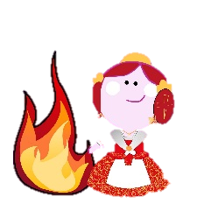



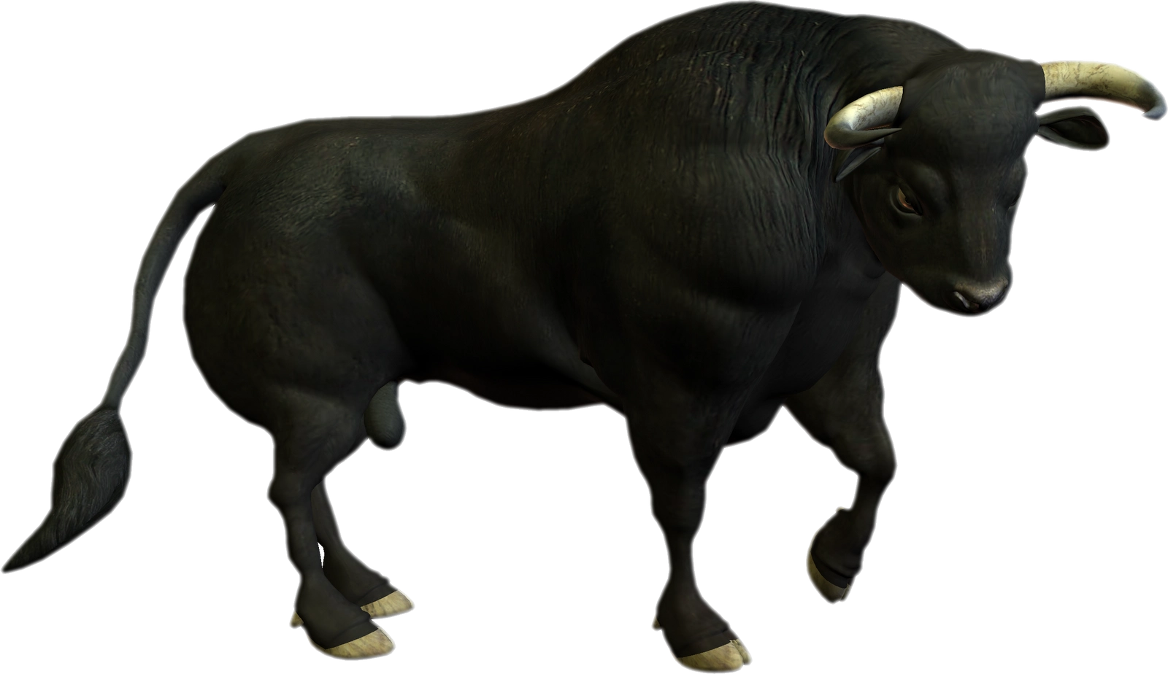




Spanish
¿Qué pasa en los encierros / las corridas de toros ? | What happens in the bull running / bull fighting?
San Fermín | A bull running festival held in Pamplona every July
Los toros | The bulls
Las calles | The streets
Correr | To run
Las corridas de toros | Bullfighting
Los encierros | Bull running
La plaza de toros | The bullring
9.12 Festivals
¿Cuál es tu festival favorito? | What is your favourite festival
Mi festival favorito es… | My favourite festival is..
La Navidad | Christmas
La Nochebuena | Christmas Eve
La Nochevieja | New Year’s Eve
El día de año nuevo | New Year’s Day
El día de los Reyes Magos | Three Wise Men Day
La Semana Santa | Easter / Holy Week
Las hogueras | The bonfires
La feria de abril | The April fair
Día de muertos | The day of the dead
El cumpleaños | Birthday
El carnaval | Carnival
La feria | Fair
El día de la madre | Mother’s day
El día del padre | Father’s day
El día festivo | Bank Holiday
El encierro | The bull running
Las fallas | Fallas
Els castells | Human towers
La Tomatina | Tomato festival
¿Qué hacemos para celebrar? | What do we do to celebrate?
Me levanto | I get up
Me ducho | I shower
Me visto | I get dressed
Recibo regalos | I receive presents
Soplo velas | I blow candles
Monto el árbol de Navidad | I put up the Christmas tree
Compro ropa nueva | I buy new clothes
Voy a la iglesia Voy a la mezquita Voy a la plaza Voy a casa de… | I go to church I go to the mosque I go to the square I go to …’s house
… llega | … arrives
Comemos… | We eat…
Ayunamos | We fast
Jugamos a juegos de mesa | We play table games
Celebramos | We celebrate
Lo paso muy bien | I have a good time
Me acuesto | I go to bed
Voy a dormir | I go to sleep
¿Qué pasa en las Fallas? | What happens in Fallas?
Fallas | A festival held in Valencia every March
La hoguera | The bonfire
El cartón | Cardboard
Las fallas | Sculptures made of cardboard
Los fuegos artificiales | Fireworks
Los petardos | Firecrackers
Las bandas de música | Music bands
¿Qué pasa en la Tomatina? | What happens in the tomato festival?
La gente | People
Lanza tomates | Throw tomatoes
Aplasta tomates | Squish tomatoes
Se ensucia | Gets dirty
Tiene lugar en Buñol | Takes place in Buñol
La batalla | The battle
El caos | Chaos
¿Cómo es? | How is it like?
Emocionante | Exciting
Conmovedor | Moving
Divertido | Fun
Insoportable | Unbearable
Impactante | Striking

Slide 49
Spanish
Reading – Top tips
• Read the introduction to the question carefully. This will help you to give sensible answers. Look for titles.
• Answer every question, especially where you have to write a letter. If in doubt, have a guess.
• Read the whole of the sentence so that you can check that your first reaction is right. If you think the answer is ‘P’ (positive) for example, read on in the text to make sure that the correct answer is not in fact ‘P and N’ (positive and negative).
• Do not copy whole chunks of the text because you might include the wrong answer as well as the right answer.
• If you are asked to give one reason or one detail, only give one.
VOCABULARY IS KEY!
Look through the vocab lists and try to refresh your memory of as much vocabulary as possible.
9.12 Festivals and Culture
Listening check-list
Before I listen …
1. read the exercise carefully, paying attention to the instructions and pictures
2. think of possible words, phrases and ideas I might hear
3. think about how these words and phrases would be pronounced
4. think of the different ways certain phrases could be expressed
While I listen, pay attention to…
5. repetition or paraphrase
6. time marker phrases
7. the questions and tasks that go with the passage
8. all the things I predicted (questions, vocabulary, possible answers)
While I listen, I work out any words I don’t know by…
9. using the words I understand to get the general meaning of the passage first
10. listening to words that come before or after the unknown word
11. using my general knowledge to think about what the unknown word might logically mean
12. listening to what comes later in the passage for further clues, or to check whether the unknown word does in fact mean what I think it means
13. using what I know about sentence structure to work out what kind of word it is (noun, adjective, verb)
14. thinking whether the unknown word is like a word I know in English or French/German/Spanish, and then checking whether that meaning would make sense
Translation – Top tips
Read the whole sentence/paragraph first.
Chunk the sentences e.g. I play / videogames / in my bedroom.
Highlight what you don’t know.
Be as ACCURATE as you can.
What are you being tested on, look out for different time markers.
Make sure you reread your translation, does it make sense?

Slide 50
Spanish
Instruction: for each homework, you will be asked to look at a particular section of your Knowledge Organiser to help you answer the questions using full sentences. Each task should take 20 minutes, Set a timer and stop when the time runs out.
Homework | Due | Task:
Homework 1 |  | 1.Follow the ‘look, cover, write, check, repeat’ method with the following vocabulary items: Me gustaría, quisiera , aprobar , casarme, buscar trabajo 2. What are the three different infinitive verb endings in Spanish? 3. Translate the adjectives below into English : Práctico, interesante, creativo, emocionante, fácil 4 Which of these sentences is NOT the future tense? (a) Después de los examenes voy a viajar con mi familia (b) Normalmente viajo con mi familia (c) Me gustaría viajar con mi familia después de los examenes 5. Fill out the below adding the correct part of aller for each pronoun Yo ____, tú ____,él ____, ella ____, nosotros/as ______, vosotros/as ______, ellos ______, ellas _______
Homework 3 |  | 1 Follow the ‘look, cover, write, check, repeat’ method with the following vocabulary items: Navidad, el día de año nuevo, la Semana Santa, el cumpleaños, el carnaval 2. Is this statement true or false? Espero, quisiera me gustaría all refer to the future tense when used with an infinitive. 3. Read these two Spanish sentences. Can you explain why there are two different endings to the adjective? Una fiesta divertida Un día divertido 4. Are the below sentences present or future tense? Write P or F Normalmente voy en España para Navidad El próximo año voy a ir a Francia para Navidad 5. Can you spot the x3 errors and correct them? Normalment, para las vacaciones de Navidad je ir con mi familia y comer juntos.
Completed?
Completed?
Notes:
For each homework you will be asked to look at a particular section of your Knowledge Organiser. Set a timer for 20 minutes.

Slide 51
Spanish
Instruction: for each homework, you will be asked to look at a particular section of your Knowledge Organiser to help you answer the questions using full sentences. Each task should take 20 minutes, Set a timer and stop when the time runs out.
Homework | Due | Task:
Homework 3 |  | Follow the ‘look, cover, write, check, repeat’ method with the following vocabulary items: Las hogueras, el cumpleaños, la feria, la Nochebuena, Día de los Muertos 2. Complete the sentence : In Spanish to say what you are going to do (the future tense) you need part of the verb _______ + ______ + the _____________ 3. What are 3 strategies we can use in listening exams? 4. What are 3 strategies we can use in reading exams? 5. Translate the 3 sentences below into Spanish : Next weekend, I am going to go the mosque Next year, I am going to do an apprenticeship Tomorrow, I am going to watch fireworks
Completed?
Notes:
For each homework you will be asked to look at a particular section of your Knowledge Organiser. Set a timer for 20 minutes.

Slide 52
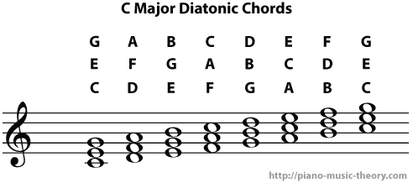
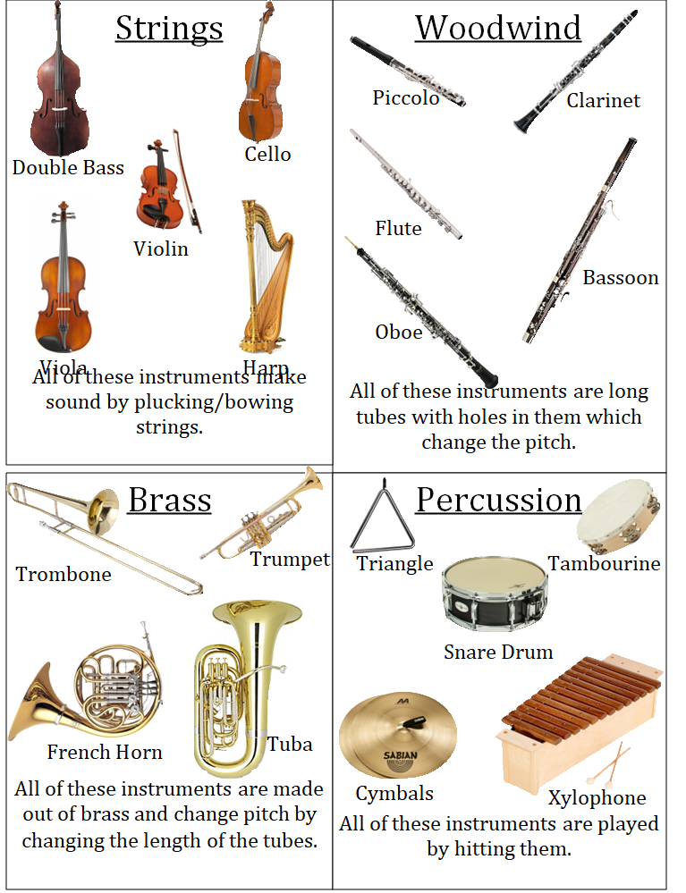
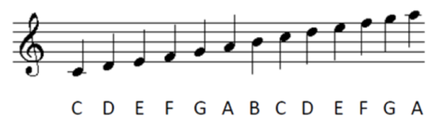
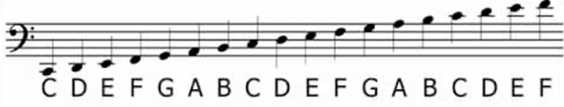
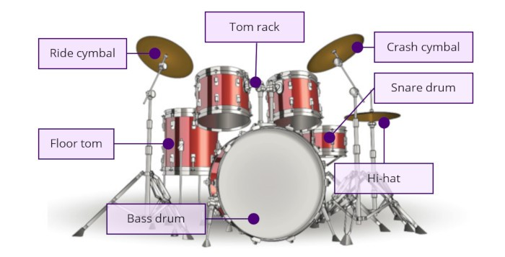

Music Page 53

Slide 53
Music
Instruction: for each homework, you will be asked to look at a particular section of your Knowledge Organiser to help you answer the questions using full sentences. Each task should take 20 minutes, Set a timer and stop when the time runs out.
Homework | Due | Task:
Homework 1 |  | Log on to www.teachinggadget.com on your computer, tablet or phone and type in the following username and password combination: Username: BBA Password: music123 Click on 'My Assignments and select your class Complete the assignments set for your class for this week
Homework 2 ​ |  | Log on to www.teachinggadget.com on your computer, tablet or phone and type in the following username and password combination: Username: BBA Password: music123 Click on 'My Assignments and select your class Complete the assignments set for your class for this week
Homework 3 ​ |  | Log on to www.teachinggadget.com on your computer, tablet or phone and type in the following username and password combination: Username: BBA Password: music123 Click on 'My Assignments and select your class Complete the assignments set for your class for this week
Completed?
Completed?
Completed?
Notes:
For each homework you will be asked to look at a particular section of your Knowledge Organiser. Set a timer for 20 minutes.

Slide 54

PSHE
PSHE – mindfulness colouring in

